Slide 1

The Basics: Transmission –Based Precautions in the Long-Term Care Setting
2024
Basic transmission-based precautions training incorporating activities and discussion for long-term care staff
Notes:
Welcome infection prevention champions! My name is Jen Malewicki and I am a principal planning analyst from the LTC IP program at Hennepin County Public Health. We are so happy to have you with us today as we cover The Basics: Transmission-Based Precautions in the Long-term Care Setting. This training is a basic training intended for long-term care staff that incorporates activities and discussion.

Slide 2
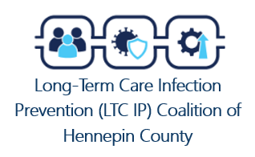

Contributions by:
David Johnson, MPH Hennepin County Public Health
Linn Warnke, RN, MPH, LTC-CIP, CIC
Hennepin County Public Health
Jen Malewicki, BSN, RN Hennepin County Public Health
Caramae Steinwand, BS
Minnesota Department of Health, Project Firstline, ICAR
Pam Powers, RN, ND Minnesota Department of Health, Project Firstline, ICAR
Kari Bergman, BSN, RN, CIC
Minnesota Department of Health, ICAR
LTC.InfectionPrevention@hennepin.us
Notes:
This training was developed by the Long-term Care Infection Prevention Coalition of Hennepin County. Thank you to those listed for your contributions! If you’d like to join this coalition or have questions, please email LTC.InfectionPrevention@hennepin.us

Slide 3
Learning objectives
Upon completion of this training, participants should be able to:
Demonstrate proper technique for donning and doffing personal protective equipment (PPE).
Describe the different types of transmission-based precautions.
Determine what PPE is appropriate based on the type of transmission-based precautions in place.
Apply transmission-based precautions knowledge to long-term care situations.

Slide 4
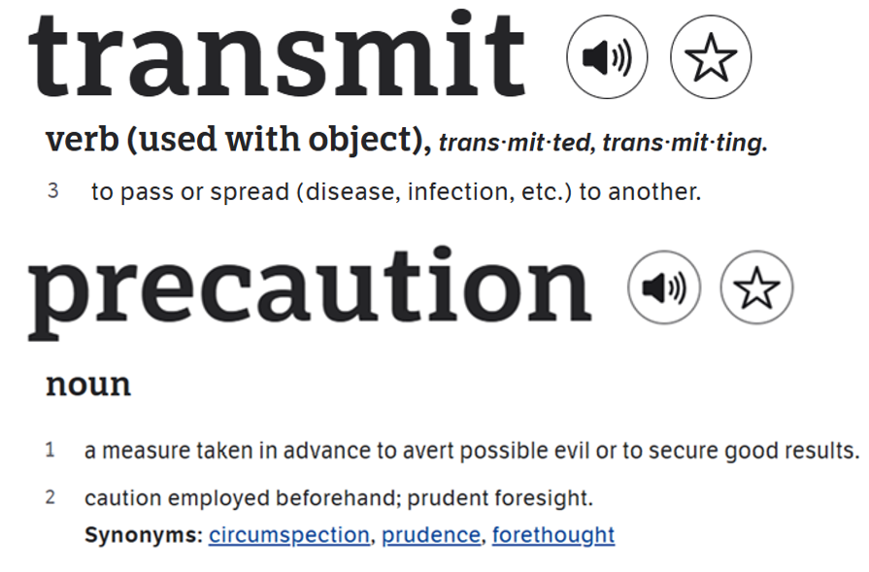
What are transmission-based precautions?
Additional measures needed to prevent spreading germs from someone who has a suspected or confirmed infection
According to CDC:
“Transmission-Based Precautions are the second tier of basic infection control and are to be used in addition to Standard Precautions for patients who may be infected or colonized with certain infectious agents for which additional precautions are needed to prevent infection transmission.”
Sources: Transmission-Based Precautions | Infection Control | CDC, PRECAUTION Definition & Meaning | Dictionary.com, TRANSMIT Definition & Meaning | Dictionary.com
Notes:
So, what are transmission-based precautions? Well according to CDC: “Transmission-Based Precautions are the second tier of basic infection control and are to be used in addition to Standard Precautions for patients who may be infected or colonized with certain infectious agents for which additional precautions are needed to prevent infection transmission”. But let’s break that down a little further. Dictionary.com states that to transmit is to pass or spread and that precaution is a measure taken in advance to avert possible evil, or to secure good results, apply caution beforehand. When we say transmission-based precautions, *click* we are taking additional measures to prevent spreading germs from someone who has a suspected or confirmed infection.

Slide 5

Standard vs. transmission-based precautions
Notes:
Before diving into transmission-based precautions, it’s important to understand how it differs from standard precautions.

Slide 6






Hand hygiene
Cleaning and disinfection
STANDARD PRECAUTIONS
Measures applied to all care activities, regardless of suspected or confirmed infection
Personal protective equipment (PPE)
Careful laundry handling
Respiratory hygiene/ cough etiquette
Safe injection practices
Source: Standard Precautions for All Patient Care | Infection Control | CDC
Notes:
Standard precautions are measures that are applied to all care activities for all residents. These measures are in place even when a resident doesn’t have a suspected or confirmed infection. Standard precautions includes performing hand hygiene with an alcohol-based hand rub or handwashing during all important moments for hand hygiene. It includes using personal protective equipment (or PPE) when it is anticipated that you will come in contact with blood or bodily fluids. You can think of this when you wear gloves during blood glucose monitoring or putting on a gown when you anticipate a treatment may have splashes or sprays. Standard precautions includes respiratory hygiene and cough etiquette such as covering your cough and sneezes. Cleaning and disinfection is another important component to standard precautions, ensuring that the environment is clean and disinfected regularly and that medical equipment used by more than one resident are disinfected after each use. Standard precautions includes carefully handling laundry to ensure that clean linens are protected from dust and germs during their transport from one area to another. And finally, safe injection practices are included in standard precautions such as never reusing a needle and using safety devices that decrease the risk for sharp injuries.
All of these precautions are applied to all resident care, all of the time and is the standard approach in preventing the spread of infection. But what about when additional measures are needed, beyond standard precautions, in order to prevent the spread of infection…?

Slide 7




TRANSMISSION-BASED PRECAUTIONS (TBP)
Additional measures needed to prevent spreading germs from someone who has a suspected or confirmed infection
Contact precautions
Droplet precautions
Airborne precautions
Enhanced-barrier precautions
Source: Standard Precautions for All Patient Care | Infection Control | CDC
Notes:
This is where transmission-based precautions apply! These are additional measures needed to prevent spreading germs from someone who has a suspected or confirmed infection. Transmission based precautions are divided into four different categories: contact precautions, droplet precautions, airborne precautions, and enhanced barrier precautions.

Slide 8
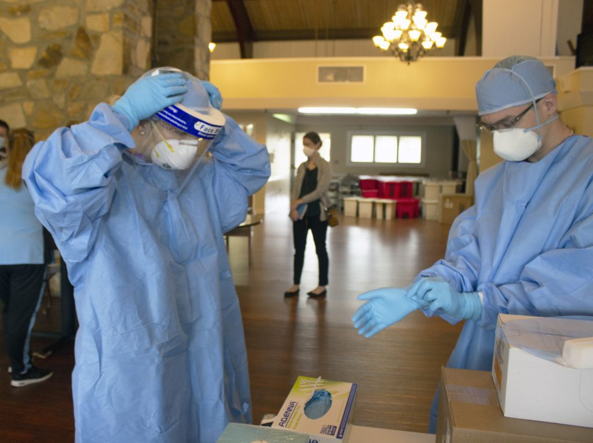
Personal protective equipment (PPE)
This Photo by Unknown Author is licensed under CC BY
Notes:
A major component of both standard and transmission-based precautions is personal protective equipment or otherwise known as PPE. Before we get into the different types of transmission-based precautions, let’s learn about the basics of PPE.

Slide 9
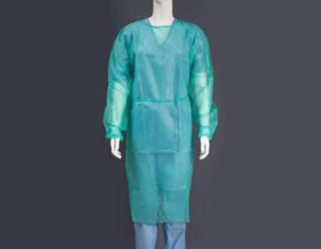

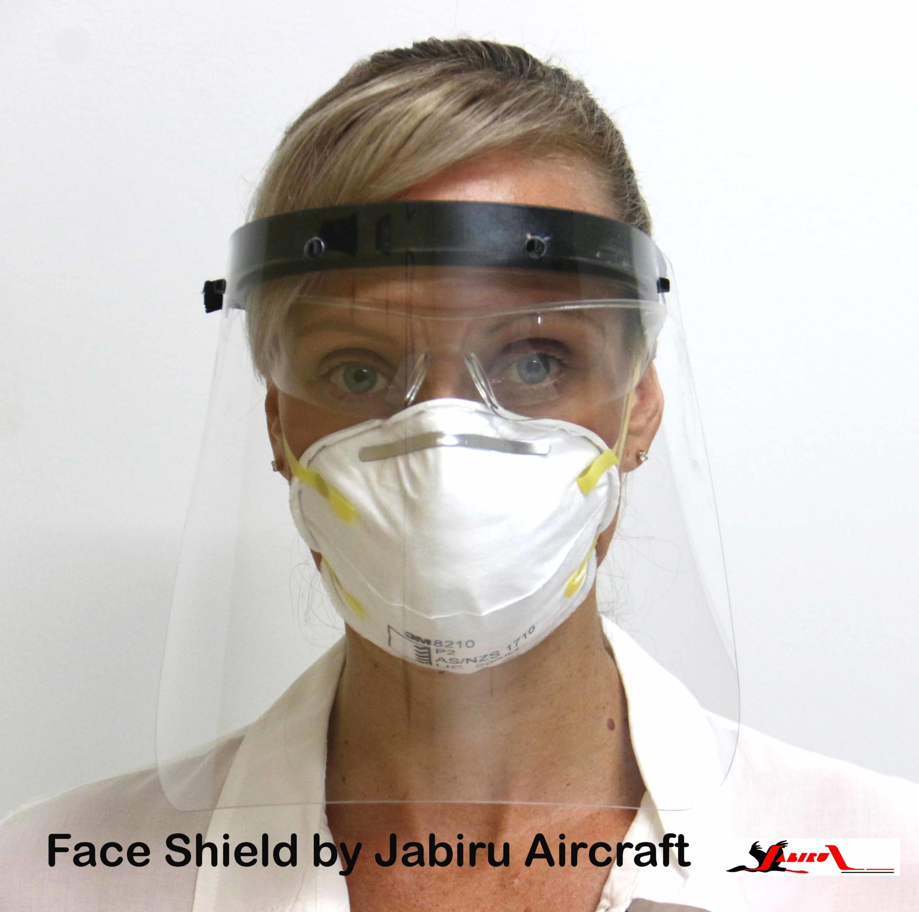
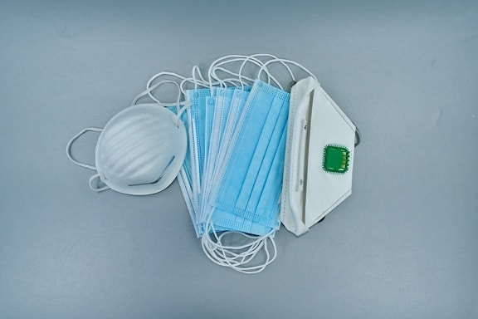
What is PPE?
PPE is designed to protect the wearer’s skin, eyes, mucous membranes, airways and clothing from infectious germs when coming in contact with or providing care for residents.
PPE includes:
Gloves
Face masks
Respirators
Gowns
Eye protection
This Photo by Unknown Author is licensed under CC BY
This Photo by Unknown Author is licensed under CC BY
Source: Greene, D. (2019). Transmission-Based Precautions. In APIC, Infection Prevention Guide to Long-Term Care (2nd Edition).
Notes:
PPE are items worn that are designed to protect wearer’s skin, eyes, mucous membranes, airways and clothing from infectious germs when coming in contact with or providing care to residents or their environment. PPE can include gloves, face masks, respirators, gowns, and eye protection such as googles or face shields.

Slide 10
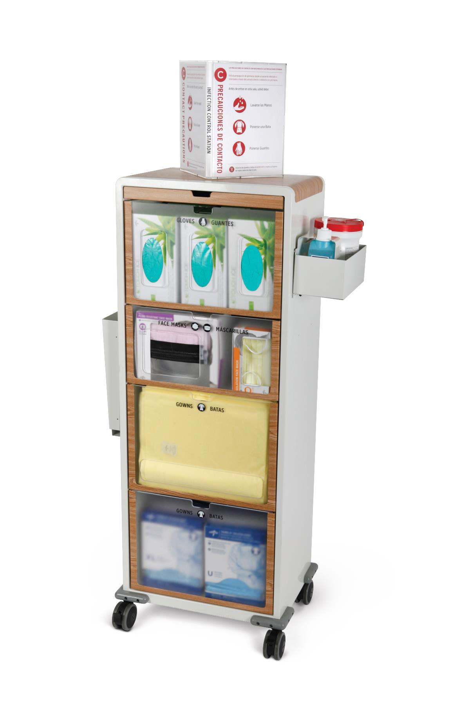
PPE storage and placement
PPE should be easily accessible at any time to initiate TBP promptly
PPE should be stored in a clean area such as a covered cart or enclosed cabinet
Image source: Medline PPE Companion Isolation Organizer Cart | Medline
Source: Behan, L et al. (2023). Standard and Transmission-Based Precautions. In The APIC Learning System for LTC-CIP.
Notes:
How PPE is stored and where it is placed is another important consideration. PPE should be easily accessible at any time for when it is required as a part of standard precautions or in order to initiate transmission-based precautions promptly. The PPE should be stored in a clean area such as a covered cart or enclosed cabinet.

Slide 11




PPE considerations
GLOVES
GOWN
MASK
EYE PROTECTION
RESPIRATOR
Disposable
Not a replacement for hand hygiene!
Fully covers arms and torso
Cloth gowns must have policy, still only one use per gown
Surgical/medical mask/procedure
Must cover mouth and nose
Must have medical evaluation and fit testing
Seal check after application
Doffed outside resident room
Goggles, or face shield
Personal eyeglasses are not PPE
*The same PPE should not be worn to care for more than one resident. Used PPE should be discarded and replaced with fresh PPE prior to caring for the next resident*
Source: Greene, D. (2019). Transmission-Based Precautions. In APIC, Infection Prevention Guide to Long-Term Care (2nd Edition).
Notes:
The are a few considerations to keep in mind when selecting and using PPE. Gloves should be disposable and non-absorbent. It’s important to remember, gloves do not replace hand hygiene! Hand hygiene should always be performed after removing gloves. Gowns should fully cover your arms and torso. Ties of the gown should be tied either in the back or on the side. If your facility uses reusable cloth gowns, there should be a policy in place indicating the appropriate place to discard a used gown to be laundered. And remember – only one use per gown – whether it is disposable or cloth. Masks should be disposable and non-absorbent. They may be referred to as a surgical, medical, or procedure mask. The mask should cover both your nose and mouth. Those who wear a respirator must have gone through a medical evaluation and properly fit tested to the specific model of respirator before wearing. When applying a respirator a seal check should be performed to ensure a proper fit. Unlike any other type of PPE, the respirator is the only item that is take off OUTSIDE of the resident room. All other PPE is typically taken off inside the resident room, near the door. Eye protection includes goggles or a face shield. Personal eyeglasses do not provide adequate protection and are not considered appropriate PPE.
A very important consideration for all PPE types is that *click* the same PPE should not be worn to care for more than one resident. Used PPE should be discarded and replaced with fresh PPE prior to caring for the next resident. By wearing used PPE from one resident to the next, your PPE is acting as a germ transmission vehicle – you are spreading the germs to other residents!

Slide 12



PPE is a barrier between the wearer’s clothing, skin, and mucous membranes – protecting us from germs!
Notes:
Let’s dive into this concept a little more…When PPE is put on, it serves as a barrier between the wearer's clothing, skin, and mucous membranes like our mouths and noses, thus protecting the wearer from the germs present on the resident and in the resident's environment.

Slide 13
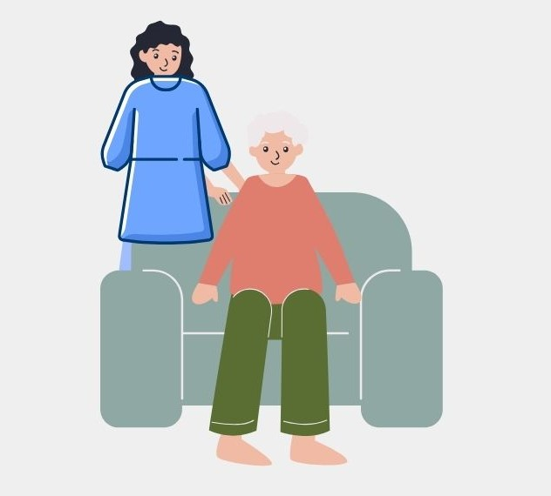
The germs cling to the PPE such as the gown, gloves, masks or eye protection instead of the healthcare worker
Notes:
During resident care, PPE like gowns and gloves will touch contaminated surfaces and masks, respirators and eye protection will serve as a barrier from germs that may splash, spray, or suspend through the air.
Remember, contamination and germs may be visible like red blood on sheets, body fluids, or excretions in the bathroom, or invisible like microscopic MRSA germs on the chair or bed rail. For the purpose of this visual, the red dots indicate germs or contaminated areas.
Essentially, the germs cling to the PPE such as the gown, gloves, masks or eye protection instead of the healthcare worker’s personal clothes, body, or mucous membranes.

Slide 14
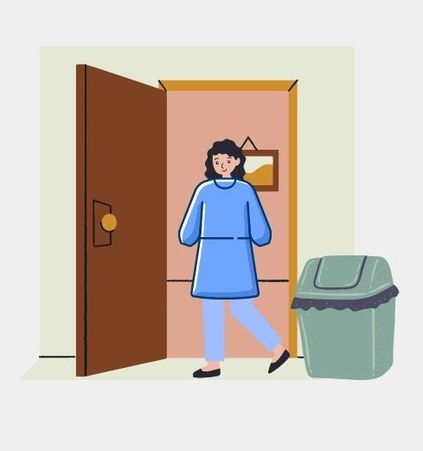
The PPE has done its job - it has protected the wearer from germs!
Notes:
The PPE has done its job, it has protected the wearer from germs! But what happens if we wear that same PPE to a different resident care environment or…

Slide 15
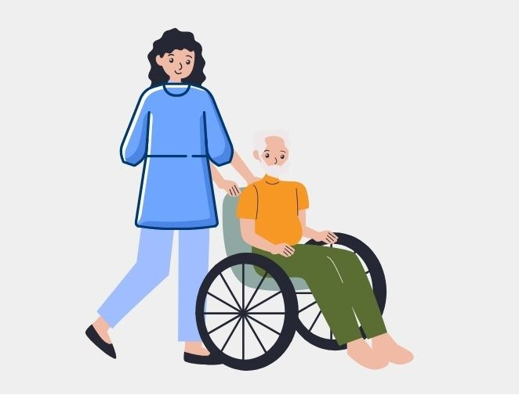
Notes:
…start to provide care to another resident with the same PPE? Well, the PPE is then acting like a germ transmission vehicle!

Slide 16

Notes:
Your used PPE has the opportunity to stop at more destinations than you may think as the germ transmission vehicle. Without taking off your used PPE before leaving that specific resident care area or upon completion of the task requiring the PPE, your PPE has the opportunity to carry that contamination to other people or surfaces. Think if you stop by a workstation and your gown rubs up against the surface of the desk or you stop to for a moment in the common area for a quick chat and place your used gloved hands on the chair, or even quickly assisting a resident with their blanket that is out of reach or their glasses on their bedside table. These are just a few of many opportunities where the germs from your used PPE can spread if not taken off and disposed of at the appropriate times.

Slide 17
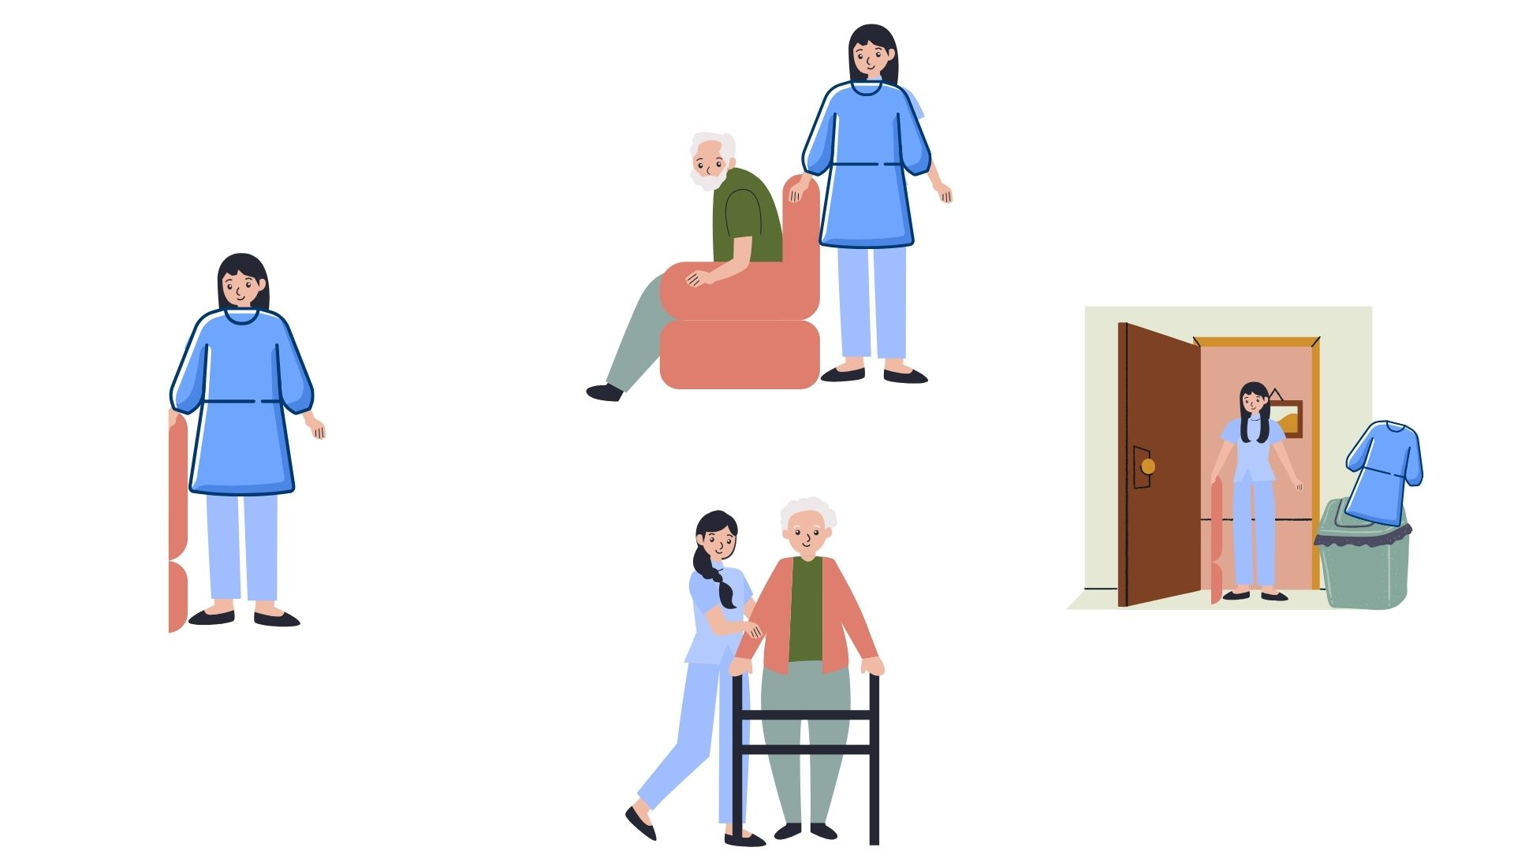

Notes:
So how do we make a roadblock for the PPE germ transmission vehicle? Well, it has a lot to do with how we put on and take off our PPE, which we will get into shortly. But first, let’s look at a similar situation and see how the germ transmission vehicle could have been prevented.

Slide 18
Notes:
As you can see in the top image, the healthcare worker provided care for the resident which ultimately contaminated their gown and gloves. The PPE did its job! Germs are on the gown instead of the healthcare workers clothes!

Slide 19
Notes:
After completing the care and before leaving the resident care environment, the healthcare worker removes and disposes their gown and gloves. Immediately after disposing the PPE, the healthcare worker performs hand hygiene to ensure to remove the germs on their hands that may have become contaminated during resident care or PPE removal.

Slide 20
Notes:
The healthcare worker than begins to care for another resident.

Slide 21

Notes:
No germ transmission vehicle here!

Slide 22
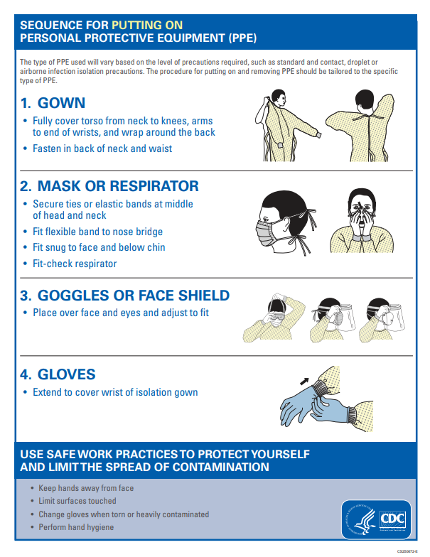
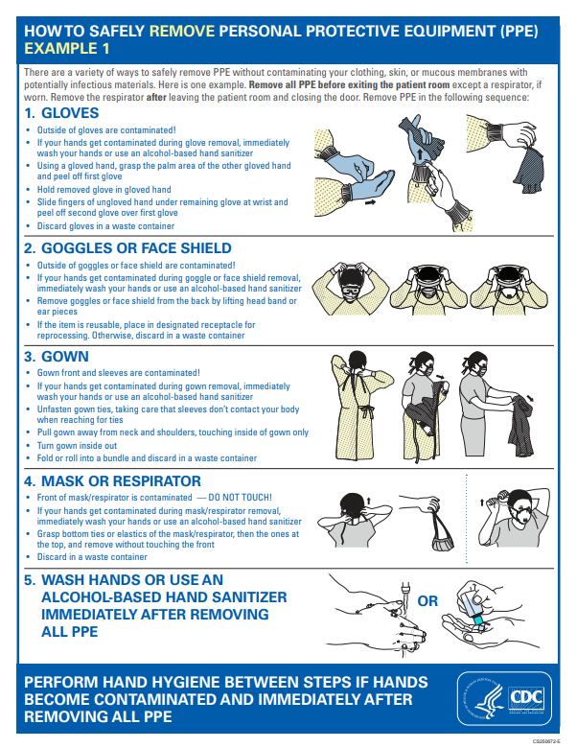
PPE donning (putting on) and doffing (taking off)
Images source: ppe-sequence-p.pdf (cdc.gov)
Notes:
CDC has several resources related to PPE and transmission-based precautions, including this step-by-step tutorial on how to properly put on (or don) PPE and how to take off (or doff) PPE. It is important to follow the appropriate steps for donning and doffing in order to avoid contaminating yourself with infectious germs.

Slide 23
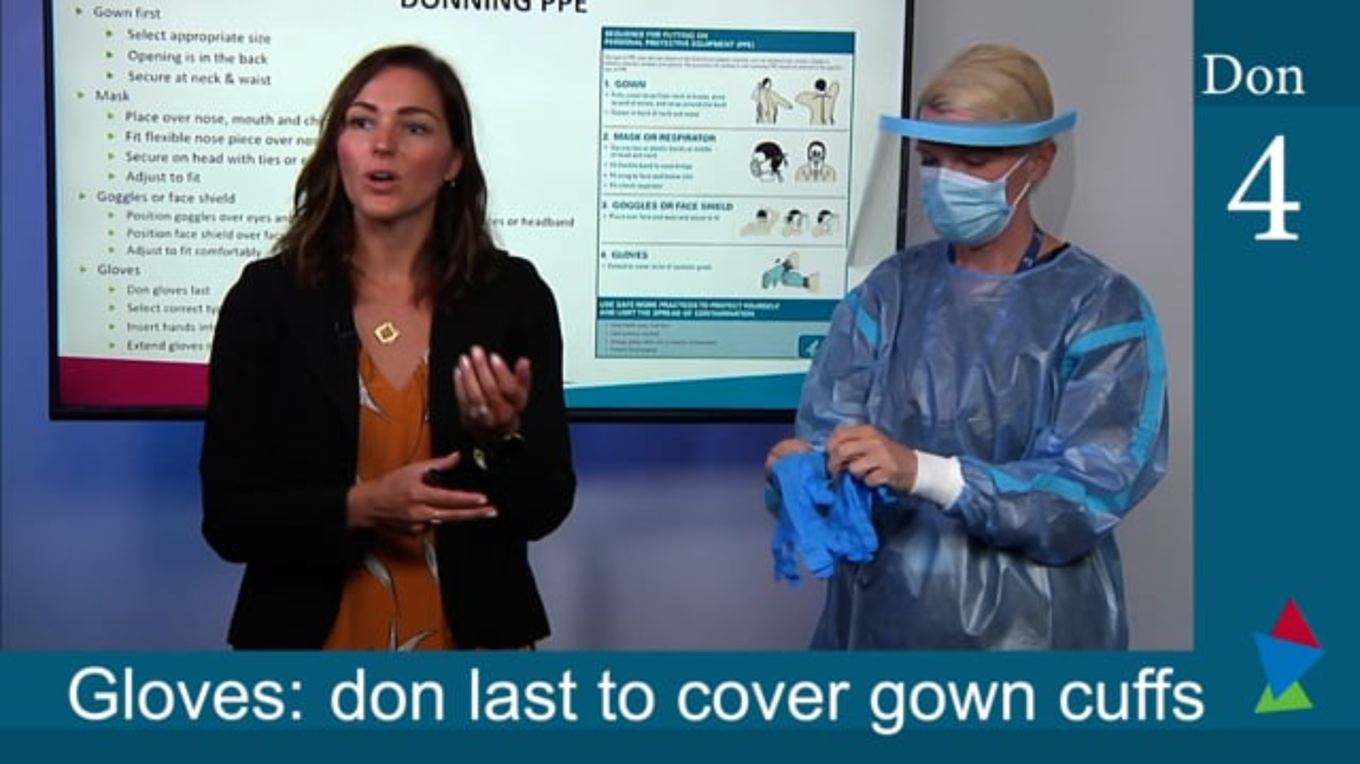
PPE donning and doffing video
Video source: Donning and Doffing PPE | SPICE
Notes:
Now let’s take a look at donning and doffing in action with this tutorial video from the North Carolina Statewide Program for Infection Control and Epidemiology, otherwise known as SPICE.

Slide 24

Application activity
Your turn to practice donning and doffing PPE!
This Photo by Unknown Author is licensed under CC BY
Notes:
Now it’s your turn to put your knowledge into practice! At this time, you will practice donning and doffing PPE. Partner up with another person and have them check your steps along the way.

Slide 25
PPE donning and doffing
Images source: ppe-sequence-p.pdf (cdc.gov)
Notes:
For reference, we will keep the donning and doffing steps on the screen as you practice.
Facilitator instructions:
While staff practice donning and doffing, make a point to interject with moments for critical thinking such as:
This poster says the first step is putting on the gown - it assumes something else has happened before this. What step is that? (hand hygiene)
Why am I tying the gown at the neck and the waist when it is so much more convenient to just tie it at the neck? What might happen if I left the lower half to flutter in the breeze as I moved about the resident's room? (you allow for direct contamination of your clothing where the gown should have been covering and/or the inside of the floppy gown touches a (potentially invisible) contaminated surface, which then contaminates your clothing). Why is this problematic? (you've just defeated the purpose of the gown)
Why would I remove gloves first? (they are the most contaminated) Why is that important? (you would self-contaminate if you tried removing other PPE with dirty hands)
Why would we remove PPE inside the resident room, with the exception of a respirator? (We don’t want to carry contaminated PPE to other care environments. Just before exiting the room, removing gloves, gown, eye protection and a face mask is appropriate because we no longer are having direct contact with the resident and can limit of contact with the resident’s environmental surfaces. It’s unlikely that any respiratory droplets could reach us while during the doffing process and before we exit. A respirator is the exception and must be removed outside the room because the airborne particles are still suspended in the air in the resident room.)

Slide 26
TRANSMISSION-BASED PRECAUTIONS
Additional measures needed to prevent spreading germs from someone who has a suspected or confirmed infection
Contact precautions
Droplet precautions
Airborne precautions
Enhanced-barrier precautions
Source: Standard Precautions for All Patient Care | Infection Control | CDC
Notes:
Now that we have a handle on standard precautions and PPE, let’s dive into the different types of transmission-based precautions. Remember, transmission-based precautions are those additional measures needed to prevent the spread of germs from someone who has a suspected or confirmed infection. These precautions include contact, droplet, airborne, and enhanced barrier.

Slide 27

Contact precautions
Notes:
Let’s get started with contact precautions.

Slide 28
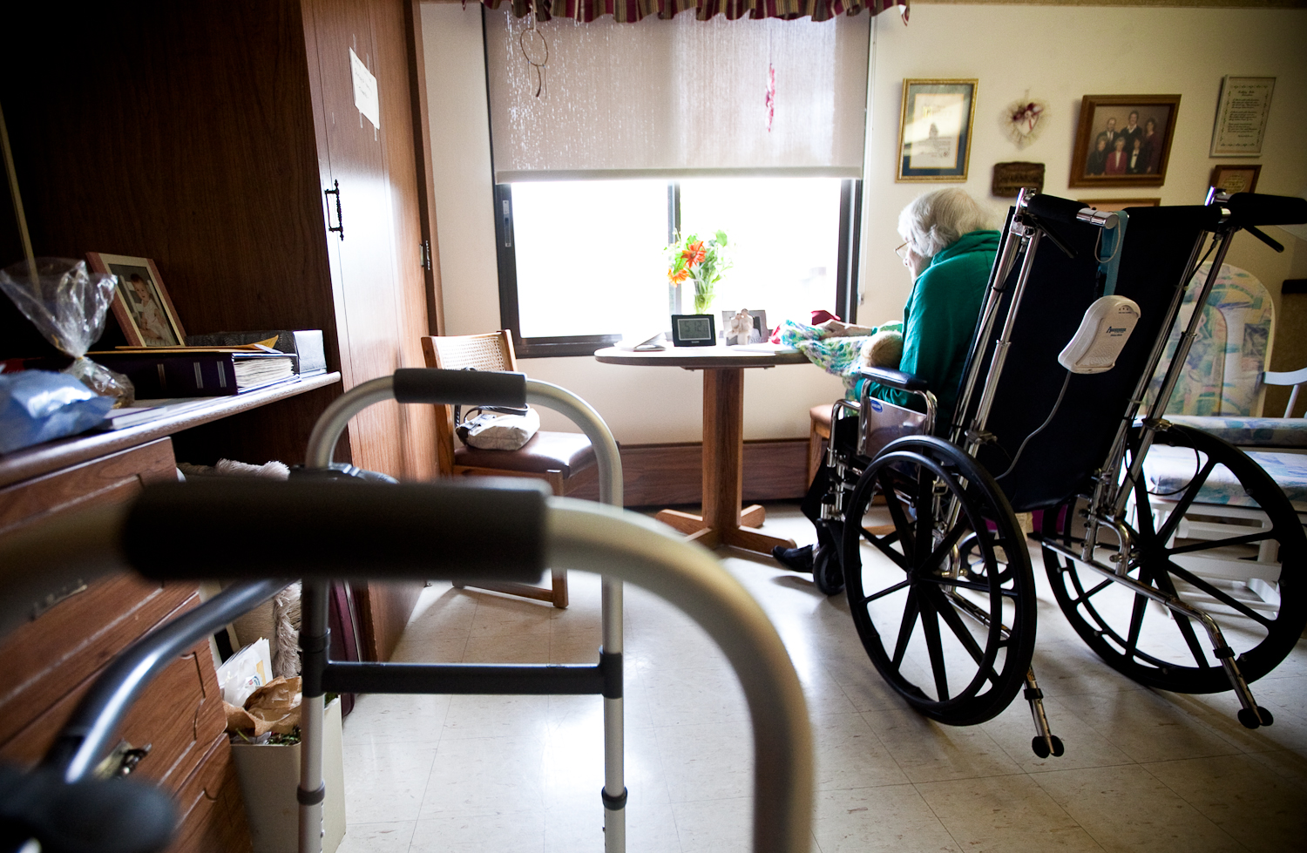
Why use contact precautions?
Contact precautions are used to prevent the transmission of infectious germs which can spread by:
  Direct contact with the resident or,
  Indirect contact, via the resident’s environment such as surfaces and resident items
This Photo by Unknown Author is licensed under CC BY-ND
Source: III. Precautions to Prevent Transmission of Infectious Agents | Infection Control | CDC
Notes:
Contact precautions are used to prevent the transmission of infectious germs that can spread by direct contact and indirect contact. When we say direct contact, think of moments that you are directly touching a resident during care activities such as assisting with a transfer or helping with hygiene. Indirect contact is when you touch the resident’s surroundings that could have the infectious germs on them. Think of when you touch resident items such as the bedside table, railings, lifts, vitals equipment or even if you’re cleaning the room.

Slide 29

Examples of conditions requiring contact precautions
C. difficile
Norovirus
Scabies
Herpes zoster (shingles)
  When lesions can’t be covered/contained
Multidrug-Resistant organisms (MDRO) (e.g., MRSA, VRE, ESBLs)
  When lesions can’t be covered/contained
This Photo by Unknown Author is licensed under CC BY-NC-ND
Source: Appendix A: Type and Duration of Precautions Recommended for Selected Infections and Conditions | Infection Control | CDC
Notes:
Some examples of conditions that require contact precautions include C. difficile (otherwise known as C. diff), norovirus (a common “stomach bug”), scabies, herpes zoster or shingles, and multidrug-resistant organisms such as MRSA and VRE. Contact precautions are not needed in all circumstances of shingles or multidrug resistant organisms (MDRO) but if the resident has lesions or cuts that can’t be covered or contained, contact precautions are indicated.

Slide 30
Examples of conditions requiring contact precautions
Can you think of a couple of symptoms that these conditions have in common?
C. difficile
Norovirus
Scabies
Herpes zoster (shingles)
  When lesions can’t be covered/contained
Multi drug-resistant organisms (e.g., MRSA, VRE, ESBLs)
  When lesions can’t be covered/contained
This Photo by Unknown Author is licensed under CC BY-NC-ND
Source: Appendix A: Type and Duration of Precautions Recommended for Selected Infections and Conditions | Infection Control | CDC
Notes:
Can you think of a couple symptoms that these conditions have in common…?

Slide 31
Examples of conditions requiring contact precautions
Excess excretions
  Vomiting
  Diarrhea
Impaired skin integrity
  Rashes
  Wounds
C. difficile
Norovirus
Scabies
Herpes zoster (shingles)
  When lesions can’t be covered/contained
Multi drug-resistant organisms (e.g., MRSA, VRE, ESBLs)
  When lesions can’t be covered/contained
This Photo by Unknown Author is licensed under CC BY-NC-ND
Source: Appendix A: Type and Duration of Precautions Recommended for Selected Infections and Conditions | Infection Control | CDC
Notes:
If you guessed excess in excretions like vomiting and diarrhea and impaired skin integrity with rashes or wounds, you’d be correct! Because of these symptoms, germs can be spread very easily from direct and indirect contact. A resident feeling queasy may have a hard time controlling their bowels and using the best hygiene practices, making it easy to contaminate their surroundings. A resident with an itchy and draining rash will have a hard time keeping those germs from spreading to other people and surfaces.

Slide 32
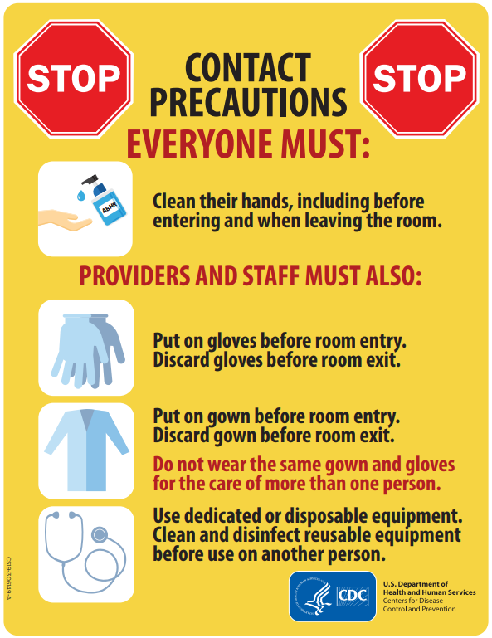
Personal protective equipment (PPE) and signage required for contact precautions
Gown
Gloves
*Resident name and infection should NOT appear on signage*
Source: contact precautions final rev3 (cdc.gov)
Notes:
For this reason, gown and gloves are the required PPE for residents on contact precautions. By wearing gloves and a gown, you are creating a barrier from the germs you may come in contact with while caring for the resident or while in the resident room.
To the right you can see an example of signage that should be placed on the resident’s room door. Clear signage is crucial to alert staff what PPE and precautions are required. The signage should never include the resident’s name or the infection to preserve resident privacy.
As always, hand hygiene must be performed before entering the room and when leaving the room. PPE should be put on before entering and taken off before exiting. As we stated before, do not wear the same gown and gloves for the care of more than one person, no germ transmission vehicles allowed!
Since indirect contact is a main mode of transmission, dedicated equipment or disposable equipment should be considered for residents on contact precautions. Dedicated equipment refers to equipment that remains in the resident’s care area for the duration of their contact precautions, like a stethoscope and bp cuff. If dedicated or disposable equipment is not possible, equipment must be cleaned and disinfected before used on another resident.

Slide 33
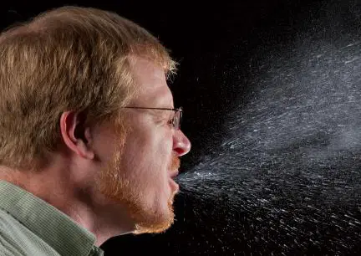
Droplet precautions
Image source: https://www.clinicaleducation.org/news/evidence-based-nutritional-strategies-for-optimal-mucosal-health-influenza-prevention/
Notes:
Photo: https://www.clinicaleducation.org/news/evidence-based-nutritional-strategies-for-optimal-mucosal-health-influenza-prevention/

Slide 34
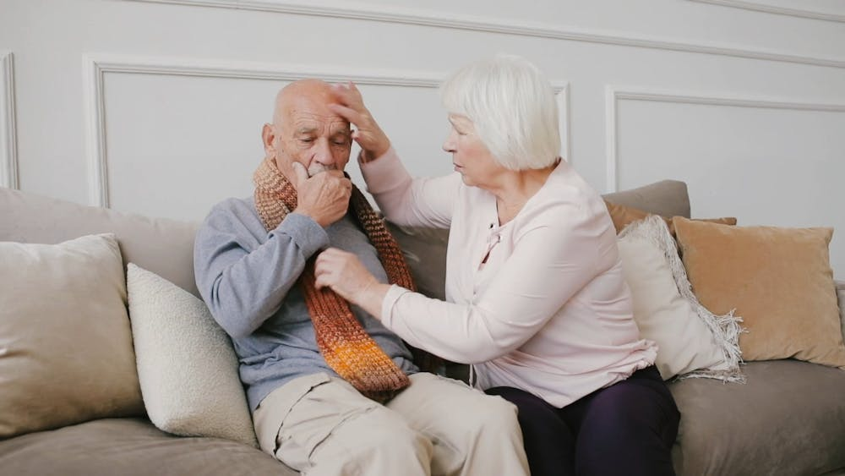
Why use droplet precautions?
Droplet precautions are used to prevent the transmission of infectious germs that are spread by large respiratory droplets. These droplets can spread up to 3 – 6 feet by:
Coughing
Sneezing
Talking
Source: III. Precautions to Prevent Transmission of Infectious Agents | Infection Control | CDC
Notes:
Droplet precautions are used to prevent the transmission of infectious germs that are spread by large respiratory droplets. These droplets can spread up to 3 – 6 feet. The germs can spread by coughing, sneezing or talking. Although these droplets can spread 3-6 feet, they don’t stay suspended in the air. Droplets drop!

Slide 35

Examples of conditions requiring droplet precautions
Influenza
Rhinovirus
Pertussis
Group A streptococcal pneumonia
Source: Appendix A: Type and Duration of Precautions Recommended for Selected Infections and Conditions | Infection Control | CDC
Notes:
Some examples of conditions that require droplet precautions include influenza, rhinovirus (the common cold), pertussis, and Group A streptococcal pneumonia.

Slide 36
Examples of conditions requiring droplet precautions
Can you think of a couple of symptoms that these conditions have in common?
Influenza
Rhinovirus
Pertussis
Group A streptococcal pneumonia
Source: Appendix A: Type and Duration of Precautions Recommended for Selected Infections and Conditions | Infection Control | CDC
Notes:
Can you think of a couple of symptoms that these conditions have in common?

Slide 37
Examples of conditions requiring droplet precautions
Cough
Runny or stuffy nose
Sneezing
Influenza
Rhinovirus
Pertussis
Group A streptococcal pneumonia
Source: Appendix A: Type and Duration of Precautions Recommended for Selected Infections and Conditions | Infection Control | CDC
Notes:
You got it! Cough, a runny or stuffy nose, and sneezing– which can lead to a lot of traveling infectious respiratory droplets that have the ability to land on your facial mucous membranes like your eyes, nose, and mouth.

Slide 38
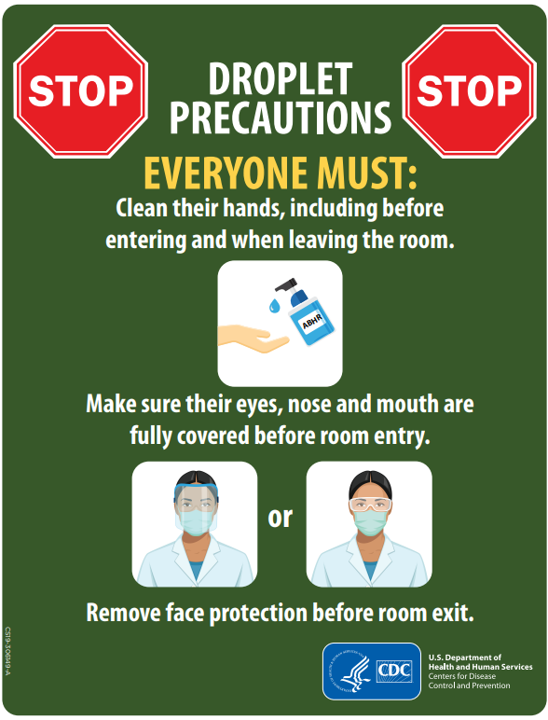
PPE and signage required for droplet precautions
Surgical mask
Eye protection (e.g., face shield or goggles)
*Resident name and infection should NOT appear on signage*
Source: droplet precautions final rev4 (cdc.gov)
Notes:
The PPE required for droplet precautions include a surgical mask and eye protection, such as a face shield or safety glasses or goggles. These items will protect you against the infectious respiratory droplets.
To the right you will see CDC’s example of signage that should be placed on the resident’s room door. As always, hand hygiene must be performed before entering the room and when leaving the room. A surgical mask and eye protection should be placed before entering the room, ensuring that eyes, nose, and mouth are fully covered. PPE should be taken off just before exiting the room.
Remember, clear signage is crucial to alert staff what PPE and precautions are required. The signage should never include the resident’s name or the infection to preserve resident privacy.

Slide 39

Airborne precautions
Image source: CSU Researchers Seek to Measure Transport of Airborne Virus Particles (colostate.edu)
Notes:
Now let’s move on to airborne precautions.

Slide 40

Why use airborne precautions?
Airborne precautions are used to prevent the transmission of infectious germs that remain suspended in the air and travel great distances due to their small size.
Source: III. Precautions to Prevent Transmission of Infectious Agents | Infection Control | CDC
Notes:
Airborne precautions are used to prevent the transmission of infectious germs that remain suspended in the air and travel great distances due to their small size.

Slide 41
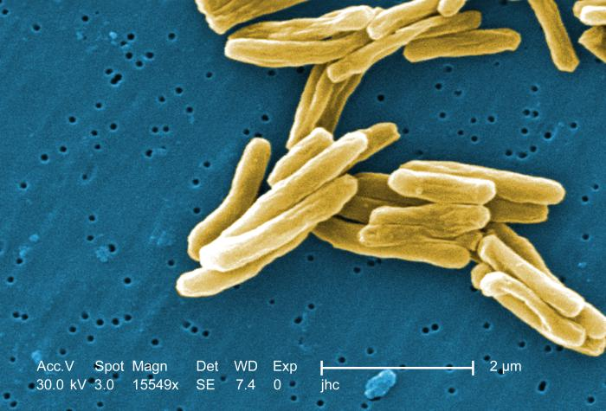
Examples of conditions requiring airborne precautions
Measles
Chickenpox
Pulmonary tuberculosis
This Photo by Unknown Author is licensed under CC BY-NC-ND
Source: Appendix A: Type and Duration of Precautions Recommended for Selected Infections and Conditions | Infection Control | CDC
Notes:
Some conditions that require airborne precautions include measles, chickenpox, and pulmonary tuberculosis.

Slide 42
Examples of conditions requiring airborne precautions
Measles
Chickenpox
Pulmonary tuberculosis
Can you think of a couple of symptoms and factors that these conditions have in common?
This Photo by Unknown Author is licensed under CC BY-NC-ND
Source: Appendix A: Type and Duration of Precautions Recommended for Selected Infections and Conditions | Infection Control | CDC
Notes:
Can you think of a couple of symptoms and factors that these conditions have in common?

Slide 43
Examples of conditions requiring airborne precautions
Measles
Chickenpox
Pulmonary tuberculosis
Cough
Rash
Vaccine preventable
Comprehensive health history is imperative!
This Photo by Unknown Author is licensed under CC BY-NC-ND
Source: Appendix A: Type and Duration of Precautions Recommended for Selected Infections and Conditions | Infection Control | CDC
Notes:
All three of these conditions have a common symptom of cough, causing even more of those tiny airborne particles to suspend through the air. Measles and chickenpox are also associated with a skin rash whereas with pulmonary tuberculosis you may see a positive tuberculosis skin test. Measles and chickenpox are both conditions that are vaccine preventable. Residents may have a higher risk of being exposed to tuberculosis if they have previously visited or lived in some countries of Asia, Africa, and Latin America where tuberculosis is more common or have spent time in homeless shelters or jails. Completing a comprehensive health history is imperative to identify resident’s vaccination status and risk factors to differentiate when common symptoms like a cough may indicate an infection that requires airborne precautions.

Slide 44
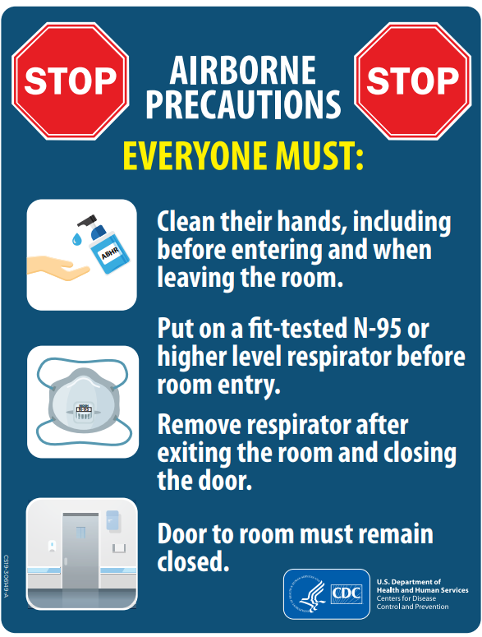
PPE and signage required for airborne precautions
Fit tested N-95 or higher level respirator
*Resident name and infection should NOT appear on signage*
Source: airborne precautions final rev3 (cdc.gov)
Notes:
Since these particles are so small, a special type of mask known as an N95 or respirator is required. N95s and respirators require a medical evaluation and fit testing to the specific model before being authorized to wear.
As always, hand hygiene should be performed upon room entry and exit. The respirator should be put on before room entry and taken off once you have exited the room and the door is closed. The door to a room on airborne precautions should remain closed.

Slide 45
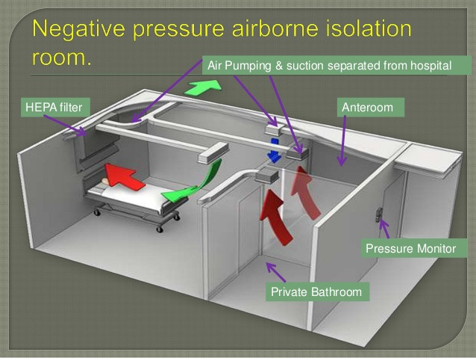
Limitations for airborne precautions
Airborne precautions requires an airborne infection isolation room (AIIRs), also known as a negative pressure room.
  Most long-term care facilities do not have AIIRs
  While awaiting transfer to a facility with an AIIR, resident should remain in a private room with the door closed
Image source: PATIENT ISOLATION ROOM NEGATIVE PRESSURE HVAC (ahgservicesllc.com)
Source: Greene, D. (2019). Transmission-Based Precautions. In APIC, Infection Prevention Guide to Long-Term Care (2nd Edition).
Notes:
Airborne precautions also require a specially ventilated room, known as an airborne infection isolation room or AIIR. This is also known as a negative pressure room. Most LTCF don’t have AIIRs and the special ventilation capacity needed for airborne precautions. If a resident has a suspected or confirmed infection that requires airborne precautions, the resident will need to be transferred as soon as possible to a facility that can accommodate airborne precautions. While awaiting transfer, the resident should remain in a private room with the door closed. Consideration should be made around the resident's ability to use a surgical mask for source control which could help contain some of the infectious particles before they have the chance to float in the air and be inhaled by others.
Your facility should have a policy and procedure in place for how to navigate a resident who requires airborne precautions and is awaiting transfer.

Slide 46

Enhanced barrier precautions
Notes:
Now let’s move on to the final precaution category; enhanced barrier precautions.

Slide 47








Why use enhanced barrier precautions?
Enhanced barrier precautions are used to prevent the transmission of multidrug- resistant organisms (MDROs) during high contact care activities.
Showering or bathing
Bathroom assistance
Transferring
HIGH CONTACT ACTIVITIES
Dressing
Device care
Providing hygiene
Changing linens
Wound care
Source: Implementation of Personal Protective Equipment (PPE) Use in Nursing Homes to Prevent Spread of Multidrug-resistant Organisms (MDROs) | LTCFs | CDC
Notes:
Enhanced barrier precautions are used to prevent the transmission of multidrug- resistant organisms (MDROs) during high contact care activities. This type of precaution is used specifically in long-term care settings.
High contact care activities include: showering or bathing, bathroom assistance, dressing, providing device care, wound care, changing linens, providing hygiene, and transferring.

Slide 48
Conditions requiring enhanced barrier precautions
CONDITIONS
Infection or colonization with an MDRO
Wounds, regardless of MDRO colonization status
Indwelling medical devices, regardless of MDRO colonization status
Enhanced barrier precautions should be applied to residents who have any of the following:
INFECTION: when a germ makes someone sick
COLONIZATION: a person is carrying a germ (e.g., MDRO) in or on them but does not have symptoms of an infection
Source: Implementation of Personal Protective Equipment (PPE) Use in Nursing Homes to Prevent Spread of Multidrug-resistant Organisms (MDROs) | LTCFs | CDC
Notes:
Unlike the other types of transmission-based precautions, enhanced barrier precautions applies to some residents who don’t have a suspected or confirmed infections. To understand enhanced barrier precautions, it’s important to understand the difference between infection and colonization.
*Click* An MDRO infection means that the person has the germ that make them sick. Colonization on the other hand means the person may have the germ in or on them but does not have any symptoms of an infection.
Conditions that require enhanced barrier precautions include residents with an infection or colonization with an MDRO, residents with wounds, regardless of MDRO status, and residents with indwelling medical device, regardless of MDRO status.

Slide 49
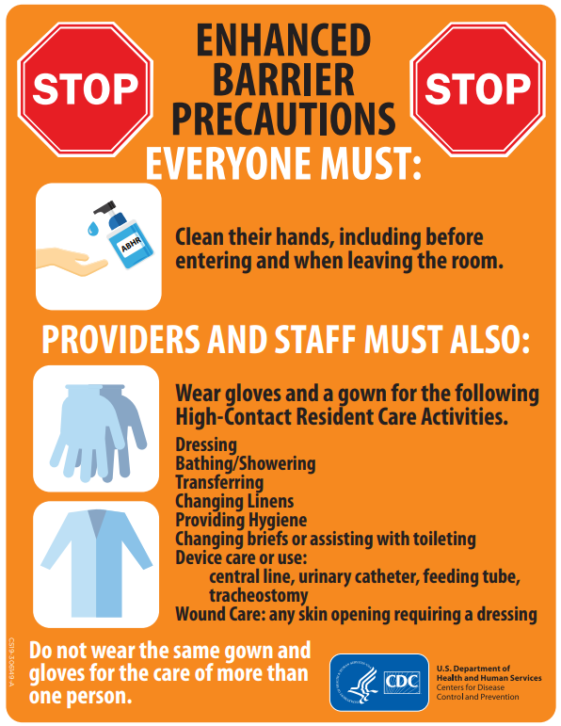
PPE and signage required for enhanced barrier precautions
Gown
Gloves
*Resident name and condition should NOT appear on signage*
Enhanced Barrier Precautions | MDH | Project Firstline
Source: https://www.cdc.gov/long-term-care-facilities/media/pdfs/enhanced-barrier-precautions-sign-P.pdf
Notes:
MDROs can be spread by direct contact which is why gown and gloves are required for those high contact activities for those on enhanced barrier precautions. Hand hygiene should be performed with all resident room entries and exits and resident rooms on enhanced barrier precautions are no exception. It is crucial to perform this step in order to disrupt the transmission of MDROs.
Like with all transmission-based precautions, it is important to have clear signage to alert staff what PPE and precautions are required, such as the sign on the right developed by CDC. The signage should never include the resident’s name or condition in order to preserve resident privacy.
*Click* If you would like to see more content on enhanced barrier precautions, check out MDH PFL EBP trainings via the link on the screen.

Slide 50

Other transmission-based precautions considerations
Notes:
Now let’s cover some other important transmission-based precautions considerations.

Slide 51
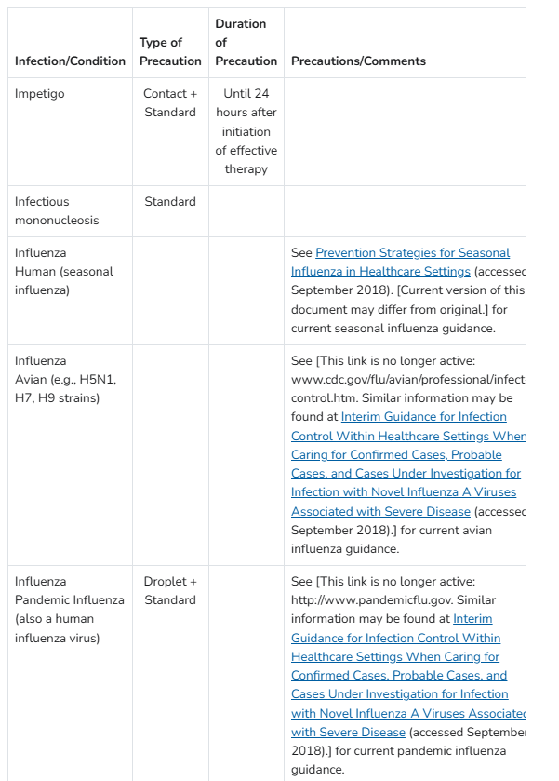
Initiation, duration, and discontinuation of transmission-based precautions
Initiated as soon as there is suspicion or confirmation of an infection that requires TBP
“TBP are generally discontinued when clinical signs and symptoms are resolved, or according to the pathogen-specific recommendations” (Behan et al., 2023, pg. 5-29).
  Pathogen specific recommendations can be found on CDC’s Appendix A
Sources: Behan, L et al. (2023). Standard and Transmission-Based Precautions. In The APIC Learning System for LTC-CIP.
Appendix A: Type and Duration of Precautions Recommended for Selected Infections and Conditions | Infection Control | CDC
Notes:
An impetrative part of transmission-based precautions is understanding when to initiate them, how long to have them in place, and when they can be discontinued.
TBP should be initiated as soon as there is suspicion or confirmation (which ever one comes first) of an infection that requires TBP. The duration can vary based on the pathogen or infection at play, and sometimes can depend on treatment that is prescribed. In general, “TBP are discontinued when the clinical signs and symptoms are resolved, or according to the pathogen specific recommendations” says Behan.
Discontinuation of enhanced barrier precautions happen when the resident no longer fits the criteria for EBP, meaning they no longer have an infection or colonization of an MDRO, they no longer have wound, and they no longer have an indwelling medical device.
Many infections and conditions can be found on CDC’s Appendix A which includes the type of precaution required and the duration of precautions along with some other helpful notes. A screenshot of the appendix is displayed on the right of the slide.
The person who makes the call to initiate and discontinue transmission-based precautions may vary from facility to facility. It may be the infection preventionist, director of nursing, or charge nurse. Make sure to understand your facility’s policy on initiating and discontinuing transmission-based precautions. It is critical that there is continued communication and assessment about the status of precautions amongst the interdisciplinary team.

Slide 52







Resident placement
Resident care equipment
Single room
Cohorting may be considered
Dedicated equipment or ensure disinfected before another resident use
TRANSMISSION-BASED PRECAUTIONS CONSIDERATIONS
Resident
transport
Interfacility transfer communication
Limit transport to medically necessary reasons
CDC’s interfacility transfer form
Environmental measures
Multiple
precautions
Daily cleaning
Ensure disinfectant used is effective against pathogen
Appendix A: Type and Duration of Precautions Recommended | CDC
Visitation
Auditing
Visitors should be educated on pathogen, risks for transmission and PPE
Used to identify strengths and gaps in practice
Sources: Greene, D. (2019). Transmission-Based Precautions. In APIC, Infection Prevention Guide to Long-Term Care (2nd Edition).
Behan, L et al. (2023). Standard and Transmission-Based Precautions. In The APIC Learning System for LTC-CIP.
Notes:
Now let’s explore some other important considerations for residents on transmission-based precautions.
Preferably, residents on contact, droplet, and/or airborne precautions should use a single room. Cohorting may be considered with residents with the same infection.
Residents on TBP should use dedicated equipment (thermometer, blood pressure cuff, etc.) or disposable equipment. Shared medical equipment must be properly disinfected per the manufacturer’s instruction prior to being used for another resident.
When it comes to resident transport, residents on contact, droplet, and/or airborne precautions should limit transportation for only medically necessary reasons and remain in their rooms. The resident should wear a mask if leaving their room on droplet or airborne precautions. Based on the risk of transmission of the pathogen, this likely will mean restricting the resident from community dining and activities for the durations of their precautions. Residents on EBP do not have any transport limitations and do not need to restricted from activities.
If a resident needs to be transferred to another facility like a hospital or other LTCF, it is essential to ensure adequate communication is established with the other facility about the resident’s TBP status. Consider using CDC’s interfacility transfer form.
Rooms of residents on TBP should be cleaned daily with a focus on high-touch areas. Ensure the disinfectant used if effective against the germs of the suspected or confirmed infection
Some infections may require more than one category of TBP. For example, a major wound with group A Streptococcus would require contact and droplet precautions; meaning gown, gloves, mask, and eye protection. As mentioned previously, CDC’s appendix A indicates which precautions are needed for common infections and conditions.
Resident’s on TBP who wish to have visitors should be educated on the pathogen, the risk for transmission, and PPE required during visitation.
Finally, routine audits should be conducted of TBP practices. This helps identify strengths and gaps in practice in order to direct improvement efforts.

Slide 53

Application activity
Group together the correct:
Scenario
Mode of transmission
Precautions
PPE
Resident condition
Notes:
Now let’s test your knowledge on transmission-based precautions. In this application activity, group together the correct

Slide 54
SCENARIO
TRANSMISSION
PRECAUTIONS
PPE
CONDITION
Charles, sudden onset of diarrhea, unable to control stool
Small infectious germs that stay suspended in the air
Contact
Surgical/medical mask and eye protection
Influenza
Eileen, sudden onset of fever, cough, stuffy nose and sore throat
Direct contact with resident or indirect contact via resident’s environment
Droplet
Gown and gloves with all resident care activities
C. difficile
Barbara, history of diabetes, worsening foot ulcer that appears infected but can be covered and contained.
Large molecules spread by coughing, sneezing, or talking
Airborne
Gown and gloves with all high-contact resident care activities
Pulmonary tuberculosis
Richard, persistent cough for the last 4 weeks, travel to Indonesia 3 months ago, positive TB test
Direct contact with resident or indirect contact via resident’s environment
Enhanced-barrier
Fit-tested N95 or higher-level respirator
A positive Klebsiella pneumoniae carbapenemase (KPC) lab result, an MDRO
Notes:
Pause the video at this time as you group the items together.
Let’s see how you did!

Slide 55
SCENARIO
TRANSMISSION
PRECAUTIONS
PPE
CONDITION
Charles, sudden onset of diarrhea, unable to control stool
Small infectious germs that stay suspended in the air
Contact
Surgical/medical mask and eye protection
Influenza
Eileen, sudden onset of fever, cough, stuffy nose and sore throat
Direct contact with resident or indirect contact via resident’s environment
Droplet
Gown and gloves with all resident care activities
C. difficile
Barbara, history of diabetes, worsening foot ulcer that appears infected but can be covered and contained.
Large molecules spread by coughing, sneezing, or talking
Airborne
Gown and gloves with all high-contact resident care activities
Pulmonary tuberculosis
Richard, persistent cough for the last 4 weeks, travel to Indonesia 3 months ago, positive TB test
Direct contact with resident or indirect contact via resident’s environment
Enhanced-barrier
Fit-tested N95 or higher-level respirator
A positive Klebsiella pneumoniae carbapenemase (KPC) lab result, an MDRO
Notes:
Let’s start with Charles. He has a sudden onset of diarrhea and unbale to control his stool. That means we are going to be concerned with direct contact with this resident or contact with the resident’s environment – and therefore should initiate Contact Precautions. Gown and gloves will be required for all resident care activities. C-diff is a condition that would fit this scenario.

Slide 56
SCENARIO
TRANSMISSION
PRECAUTIONS
PPE
CONDITION
Charles, sudden onset of diarrhea, unable to control stool
Small infectious germs that stay suspended in the air
Contact
Surgical/medical mask and eye protection
Influenza
Eileen, sudden onset of fever, cough, stuffy nose and sore throat
Direct contact with resident or indirect contact via resident’s environment
Droplet
Gown and gloves with all resident care activities
C. difficile
Barbara, history of diabetes, worsening foot ulcer that appears infected but can be covered and contained.
Large molecules spread by coughing, sneezing, or talking
Airborne
Gown and gloves with all high-contact resident care activities
Pulmonary tuberculosis
Richard, persistent cough for the last 4 weeks, travel to Indonesia 3 months ago, positive TB test
Direct contact with resident or indirect contact via resident’s environment
Enhanced-barrier
Fit-tested N95 or higher-level respirator
A positive Klebsiella pneumoniae carbapenemase (KPC) lab result, an MDRO
Notes:
Next, let’s visit Eileen. She has a sudden onset of fever, cough, stuffy nose and sore throat. This sounds like a respiratory illness and we’ll be concerned that she can transmit germs via large molecule by coughing, sneezing or talking. This means we should implement droplet precautions. With droplet precautions, we will want to make sure we wear surgical mask and eye protection. Influenza is a condition that would fit this scenario.

Slide 57
SCENARIO
TRANSMISSION
PRECAUTIONS
PPE
CONDITION
Charles, sudden onset of diarrhea, unable to control stool
Small infectious germs that stay suspended in the air
Contact
Surgical/medical mask and eye protection
Influenza
Eileen, sudden onset of fever, cough, stuffy nose and sore throat
Direct contact with resident or indirect contact via resident’s environment
Droplet
Gown and gloves with all resident care activities
C. difficile
Barbara, history of diabetes, foot wound that appears infected but can be covered and contained.
Large molecules spread by coughing, sneezing, or talking
Airborne
Gown and gloves with all high-contact resident care activities
Pulmonary tuberculosis
Richard, persistent cough for the last 4 weeks, travel to Indonesia 3 months ago, positive TB test
Direct contact with resident or indirect contact via resident’s environment
Enhanced-barrier
Fit-tested N95 or higher-level respirator
A positive Klebsiella pneumoniae carbapenemase (KPC) lab result, an MDRO
Notes:
Let’s take a look at Barbara. She has a history of diabetes and a wound on her foot that appears infected but can be covered and contained. Given her wound, we are concerned with direct contact with the resident or the resident’s environment. This would mean enhanced barrier precautions apply and gown and gloves should be used with high-contact care activities. Having a positive Klebsiella pneumoniae carbapenemase (KPC) lab result, which is an MDRO, is a condition that would fit this scenario.

Slide 58
SCENARIO
TRANSMISSION
PRECAUTIONS
PPE
CONDITION
Charles, sudden onset of diarrhea, unable to control stool
Small infectious germs that stay suspended in the air
Contact
Surgical/medical mask and eye protection
Influenza
Eileen, sudden onset of fever, cough, stuffy nose and sore throat
Direct contact with resident or indirect contact via resident’s environment
Droplet
Gown and gloves with all resident care activities
C. difficile
Barbara, history of diabetes, worsening foot ulcer that appears infected but can be covered and contained.
Large molecules spread by coughing, sneezing, or talking
Airborne
Gown and gloves with all high-contact resident care activities
Pulmonary tuberculosis
Richard, persistent cough for the last 4 weeks, travel to Indonesia 3 months ago, positive TB test
Direct contact with resident or indirect contact via resident’s environment
Enhanced-barrier
Fit-tested N95 or higher-level respirator
A positive Klebsiella pneumoniae carbapenemase (KPC) lab result, an MDRO
Notes:
And finally, let’s review Richard’s situation. He has a persistent cough for the last 4 weeks, he was in Indonesia 3 months ago, and has had a positive TB test. This raises concern that small germs may spread and stay suspended in the air. This would indicate a need for airborne precautions and wearing a fit tested N95 respirator. Pulmonary tuberculosis is a condition that would fit this scenario.

Slide 59
SCENARIO
TRANSMISSION
PRECAUTIONS
PPE
CONDITION
Charles, sudden onset of diarrhea, unable to control stool
Small infectious germs that stay suspended in the air
Contact
Surgical/medical mask and eye protection
Influenza
Eileen, sudden onset of fever, cough, stuffy nose and sore throat
Direct contact with resident or indirect contact via resident’s environment
Droplet
Gown and gloves with all resident care activities
C. difficile
Barbara, history of diabetes, worsening foot ulcer that appears infected but can be covered and contained.
Large molecules spread by coughing, sneezing, or talking
Airborne
Gown and gloves with all high-contact resident care activities
Pulmonary tuberculosis
Richard, persistent cough for the last 4 weeks, travel to Indonesia 3 months ago, positive TB test
Direct contact with resident or indirect contact via resident’s environment
Enhanced-barrier
Fit-tested N95 or higher-level respirator
A positive Klebsiella pneumoniae carbapenemase (KPC) lab result, an MDRO
Notes:
Way to go, you’ve completed the activity and this training on transmission-based precautions.

Slide 60

Please take as little as 5 minutes to provide feedback on this training!
Upon completion of the survey, you will receive a proof of attendance certificate.
We do our best to incorporate your feedback into future resources.
Thank you!
https://hennepinco.az1.qualtrics.com/jfe/form/SV_1MFXe7GT0a87cUu
LTC.InfectionPrevention@hennepin.us
Notes:
Before you leave, on behalf of the Long-term Care Infection Prevention Coalition of Hennepin County, thank you for attending this training. We encourage you to take this extremely short survey to tell us how we did and to provide suggestions on how we can improve. You can access the survey using the QR code pictured or the link on the screen. Upon completion of the survey, you will receive a proof of attendance certificate. We do our best to incorporate your feedback into future resources.
If you’d like to join this coalition or have questions, please email LTC.InfectionPrevention@hennepin.us

Slide 61
Resources
Transmission-Based Precautions | Infection Control | CDC
Appendix A: Type and Duration of Precautions Recommended for Selected Infections and Conditions | Infection Control | CDC
Frequently Asked Questions (FAQs) about Enhanced Barrier Precautions in Nursing Homes | LTCFs | CDC
Enhanced Barrier Precautions (EBP) Implementation—Observations Tool | CDC
Inter-Facility Infection Control Transfer Form for States Establishing HAI Prevention Collaboratives (cdc.gov)
Table: Summary of Personal Protective Equipment (PPE) Use and Room Restriction When Caring for Residents in Nursing Homes: (cdc.gov)
Enhanced Barrier Precautions (EBP) Implementation—Observations Tool (cdc.gov)
Enhanced barrier precautions sign | CDC
Enhanced Barrier Precautions Presentation by CDC LTC Team | CDC
Fit Test FAQs | NPPTL | NIOSH | CDC
Multidrug-resistant organisms | MDH | Project Firstline
ICAR Infection Prevention Audit Tools | MDH

