Slide 2


Hennepin County Ryan White Program
Subrecipient onboarding – MCHACP

Slide 3

MCHACP Council Coordinator
Aamina Abdirashid Mohamed is the Planning Council Coordinator supporting the administration of MCHACP.
Please reach out to Aamina with questions, concerns, recruitment opportunities, etc.
Aamina.AbdirashidMohamed@Hennepin.us.

Slide 4
Key Terms and Acronyms
CEO | Chief Elected Official
Consumers/Clients/Unaligned Consumers | People living with HIV/AIDS in Minnesota
EMA | Eligible Metropolitan Area
HRSA/HAB | Health Resources & Services Administration, HIV/AIDS Bureau (Federal Agency responsible for administering Ryan White Grant funding)
MCHACP | Minnesota Council for HIV/AIDS Care & Prevention, sometimes referred to as "the council"
PC/PB | Planning Council/Planning Body
PLWH | People Living with HIV/AIDS
Providers/Subrecipients | Ryan White-funded organizations serving People living with HIV/AIDS in Minnesota
PSRA | Priority Setting & Resource Allocation
Recipients | Government entities like Hennepin County and MN Department of Human Services (DHS) receiving Ryan White funds directly from Health Resources & Services Administration (HRSA)
HC RWHAP | Hennepin County Ryan White HIV/AIDS Program
TGA | Transitional Grant Area
Hennepin County Ryan White Program
Subrecipient onboarding – MCHACP

Slide 5
How Ryan White Part A Funds Reach the Community
Awards Ryan White funds to identified jurisdictions (EMAs & TGAs)
CEO
Receives funds
Planning Council
Assesses needs of local people living with HIV
Contracts with service providers in line with Planning Council priorities, allocations, and directives
HRSA
Delegates administration of funds to the recipient
Establishes the Planning Council
Recipient
Sets services priorities based on available data
Allocates resources based on available data
Issues services directives
Subrecipient Providers
Delivers medical care and support services to PLWH in the jurisdiction
Complies with grant fiscal and program requirements
Hennepin County Ryan White Program
Subrecipient onboarding – MCHACP

Slide 6

Central Role of Planning Council
Capture community experience and voice
Provide formalized opportunities/roles for continuous community input for consumers of Ryan White Program services
Shape a system of HIV care at the local level to reflect jurisdictional needs and priorities
Consider the needs of the communities most impacted by HIV/AIDS when setting priorities and resource allocations
Hennepin County Ryan White Program
Subrecipient onboarding – MCHACP

Slide 7

Uniqueness of Planning Council
Ryan White Part A Planning Councils are unique as no other federal health/human services programs require such bodies.
Many federal programs require community planning, but planning bodies are often considered advisory rather than directive.
Federally funded non-profits like community health centers are sometimes required to include consumers on their boards.
Some planning bodies require consumer input but rarely 33% of voting members are required to be receiving services.
Almost none have such specific legislative responsibilities.
Hennepin County Ryan White Program
Subrecipient onboarding – MCHACP

Slide 8
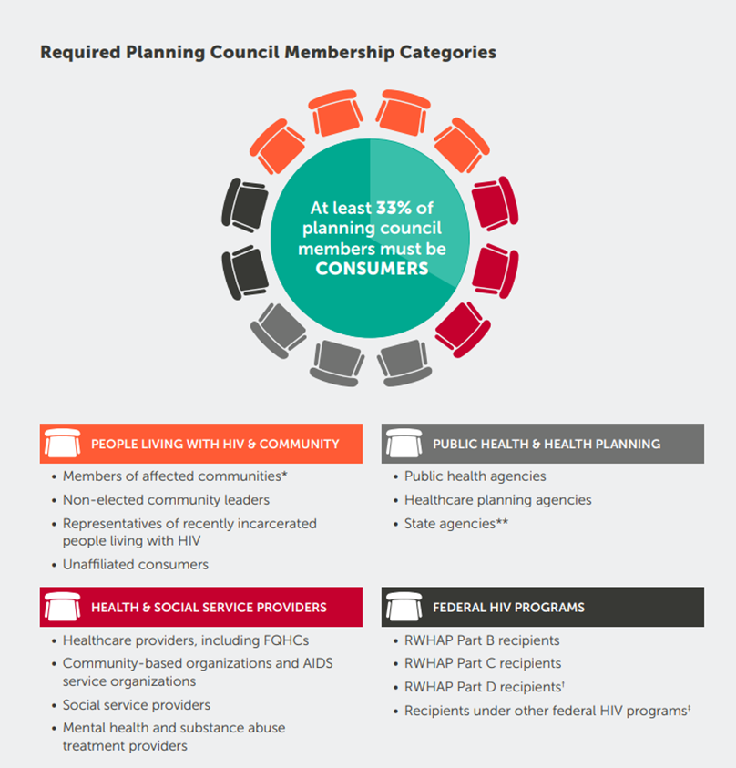
Planning Council Make-Up
Hennepin County Ryan White Program
Subrecipient onboarding – MCHACP

Slide 9
Planning Council Community Membership
There is an alternative to full Council membership. The Community Membership option offers participants who wish to participate on the committee level to become a community member for any committee.
Once an individual has satisfied the committee’s eligibility requirements (attend 3 out of 4 committee meetings in a row), they are eligible to vote on issues brought before the committee.
Community members may also attend full Council meetings but voting privileges are limited to their committee.

Slide 10
Subrecipient: Roles & Responsibilities
Follow service standards jointly developed by the recipient and the planning council (Service Standards - MCHACP (mnhivcouncil.org)). Service standards outline the elements and expectations a Ryan White Service provider follows when delivering a specific service to ensure that all Ryan White service providers offer the same fundamental components of a given service.
Cooperate with needs assessment efforts such as surveys and focus groups of people living with HIV and providers.
Participate as subject matter experts and as advocates for people living with HIV.
Encourage community attendance at committee and planning council meetings. All meetings are public, and interested providers and clients are welcome to attend.
Encourage collaboration among diverse stakeholders, including consumers and other people living with HIV, providers, the local health department, researchers, and other community members, with everyone sitting at the same table and working together to make the best decisions for the community.

Slide 11
Recipient: Roles & Responsibilities
Attend and make recipient reports at planning council meetings
Regularly provide agreed-upon reports and data (e.g., costs and service utilization)
Provide advice on areas of expertise without unduly influencing discussions or decisions
Assign staff to attend most committees regularly
Collaborate on shared roles
Carry out joint efforts such as task forces and special analyses consistent with roles and resources
Ensure that planning council operations are consistent with Ryan White legislation
Hennepin County Ryan White Program
Subrecipient onboarding – MCHACP

Slide 12
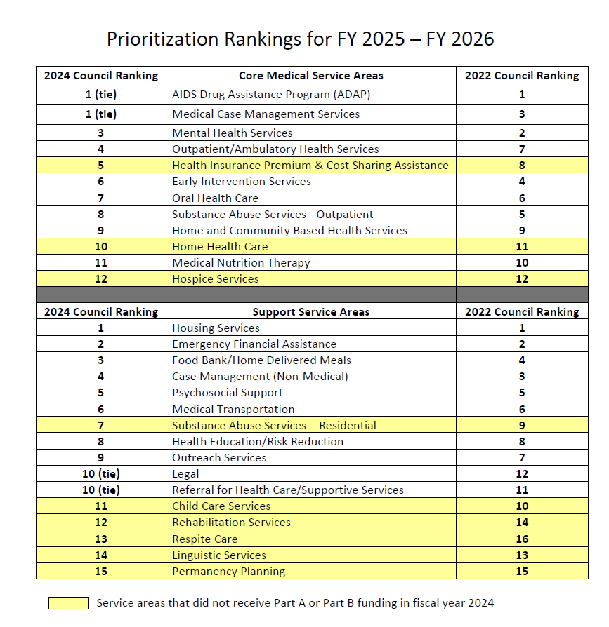
Priority Setting and Resource Allocations (PSRA)
PSRA is the council's most important as it greatly influences the system of HIV care in the area.
Priority Setting is the process of deciding which HIV services are the most important in the area.
Resource Allocation is the process of deciding how much Ryan White funds to provide for each prioritized service priority.
PSRA must be based on evidence including local HIV epidemiology, consumer needs assessments, other sources of funding, and HIV-related health outcomes and disparities along the HIV care continuum.
Hennepin County Ryan White Program
Subrecipient onboarding – MCHACP

Slide 13
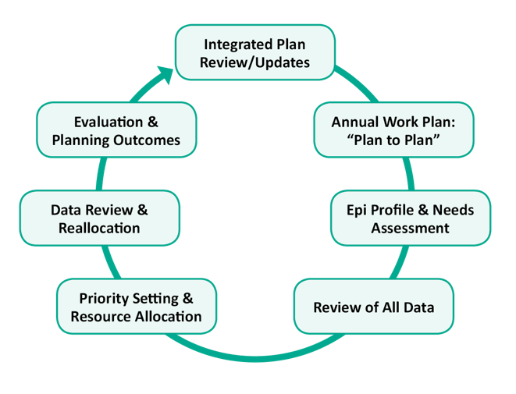
Benefits of Annual Ryan White Planning Cycle
Provides a transparent, public process for assessing community needs and allocating appropriate resources
Contributes to improvements at each step of the HIV Care Continuum
Helps identify and reduce health disparities in HIV services and outcomes
Provides opportunities for cooperation/collaboration with HIV Prevention and other local Ryan White-funded provider initiatives
Hennepin County Ryan White Program
Subrecipient onboarding – MCHACP

Slide 14


MCHACP meetings
For PDFs of our flyers to share, post, and distribute please check our website here:
mnhivcouncil.org/membership.html#Apply.

Slide 15
Why should you join the council?
Click here to apply to the council
Be a voice in program planning and implementation
  Help determine the needs of those living with, at risk for, or affected by HIV/AIDS
  Learn about and collaborate on HIV/AIDS funding and programming decisions
  Ensure that both you and your agency's voice is heard by the council and by the grant recipients
Help people affected by and at risk for HIV
Improve services and access to care
Represent an underrepresented community or population
Create services standards of care
Personal and professional benefits
  Increase your awareness of HIV/AIDS prevention, treatment, and services
  Establish contacts and networks
  Receive numerous training opportunities
  All council and committee meetings have virtual attendance options.
Hennepin County Ryan White Program
Subrecipient onboarding – MCHACP

Slide 16
Summary
Minnesota Council for HIV/AIDS Care & Prevention (MCHACP) has clearly defined legislative responsibilities
MCHACP sets priorities, allocates resources, and gives recommendations and/or directives to recipients on how best to meet these priorities.
MCHACP decisions must be data-based, using the best available data as collected and provided by the recipient.
Responsibilities emphasize the importance of committee work and engagement.
MCHACP collaborates with the grant recipients, directing Part A (Hennepin County) and advising Part B (DHS) and Prevention (MDH).
MCHACP is the coordinated opportunity for consumers of RWHAP services to have a voice in the way HIV services are funded and delivered.
Hennepin County Ryan White Program
Subrecipient onboarding – MCHACP

