Slide 2

Ryan White Quality Management (QM)
Hennepin County Ryan White Program
Subrecipient onboarding – Quality Management (Updated FY26)

Slide 3
Overview
Notes:
Aurin

Slide 4

What is Quality?
The degree to which a health or social service meets or exceeds established professional standards and user expectations (source: HRSA HAB & IoM)
Examples include:
  Addressing epi and health outcome disparities through service enhancements
  Evaluating accuracy and efficacy of data collection procedures
  Fixing system glitches that affect referrals, client services flow, retention, or client satisfaction
Hennepin County Ryan White Program
Subrecipient onboarding – Quality Management

Slide 5
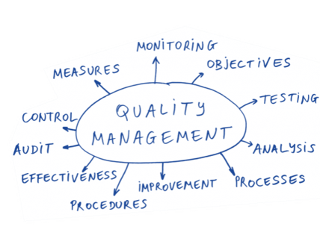
Purpose of Ryan White Quality Management
Improve health outcomes
Stay compliant
Try out new approaches to learn and improve!
Ensure funded services are consistent with:
  Public Health Guidelines on HIV treatment
  Client needs
  Guidelines for improvement in access to as well as quality
  of HIV services
  Meeting standards of care
  Addressing emerging or unearthed disparities
  HRSA Grant Requirements
Hennepin County Ryan White Program
Subrecipient onboarding – Quality Management

Slide 6
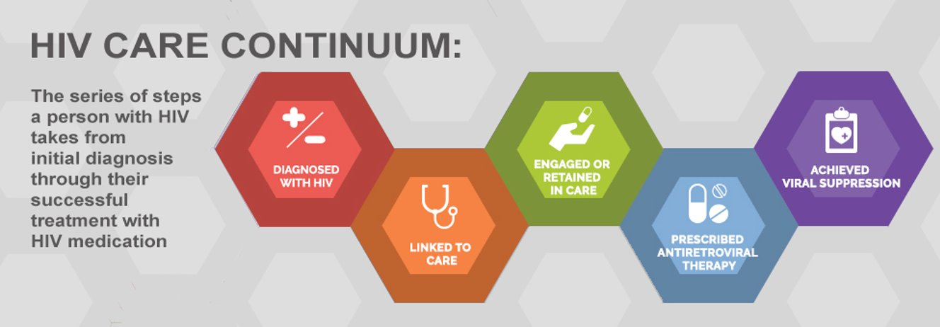
Quality Management goals aim to:
Increase Viral Suppression ● Reduce Infections ● Prove Impact ● Illuminate What Works
Source: https://www.hiv.gov/federal-response/policies-issues/hiv-aids-care-continuum/
Hennepin County Ryan White Program
Subrecipient onboarding – Quality Management

Slide 7
HC RWP Quality Management Team Oversight
Quality Management Advisory Committee (QMAC)
Drafting/Assessing of yearly performance measures at the QMAC and in Quarterly Report Calls
Drafting/Assessing of yearly unified RW Part A QI Goals at the QMAC and in Quarterly Report Calls
Performance Measure and QI Plan Advisement and Guidance for subrecipients through training and TA
Client/Consumer Quality Engagement
Quality Learning Community (QLC) & Basecamp
Early Identification of Individuals living with HIV/AIDS (EIIHA) Goals and Workgroup
Additional initiatives that may arise
Hennepin County Ryan White Program
Subrecipient onboarding – Quality Management

Slide 8
QM Expectations of Subrecipients
Have at least one staff member represent your organization and its clients at the QMAC.
Suggest and implement QI processes and projects that align with performance measure and unified RW Part A QI efforts
Report and provide feedback at the QMAC and in quarterly reports on any trends and activities related to performance measures
Report and provide feedback at the QMAC and in quarterly reports about how the QI Plan goals are being implemented (if applicable) at your organization as well as any resulting learning that arises from it.
Meet universal and service-specific standards.​
Please ask questions and request TA or training when you need or want support!
Hennepin County Ryan White Program
Subrecipient onboarding – Quality Management

Slide 9
Quality Management Advisory Committee (QMAC)
Notes:
Aurin

Slide 10
Quality Management Advisory Committee (QMAC)
QMAC meets quarterly on the third Thursday of February, May, August, and November and is comprised of:
  Minnesota funders
  At least one representative from all Part A TGA subrecipient providers
  Consumers/clients/community of publicly funded HIV services
  Guests are welcome
QMAC provides advice on system-wide CQM initiatives across publicly funded HIV services by:
  Reviewing the annual funder quality management plan
  Establishing performance measures and unified RW Part A QI goals based on data, unearthed disparities, and previous performance
  Quarterly Assessing, discussing, and advising on performance data and QI goals
  Collaborating, learning from, and sharing with other providers and consumers
  Learning, practicing, and implementing quality concepts
Hennepin County Ryan White Program
Subrecipient onboarding – Quality Management

Slide 11
Performance Measures
Notes:
Aurin

Slide 12
Performance Measures guidance per the HC RWP CQM Plan
The HC RWP Quality Management Coordinator, with advisement from QMAC, selects performance measures related to the HIV continuum of care for each funded service area, in accordance with HRSA/HAB Policy Clarification Notice (PCN) 15-02. Data is then collected and analyzed quarterly. Outcomes are reviewed to assess for health disparities and to inform of possible quality improvement activities. Results are reviewed in totality for all Part A TGA providers at the quarterly QMAC meeting and individually with pertinent providers during their quarterly report calls. If a provider is running into challenges related to performance measures in total or within a specific group of focus, the Quality Management Coordinator will work with them to identify the issues and provide technical assistance and/or training to support performance improvement.

Slide 13
Performance measures
HRSA's Policy Clarification Notice (PCN) 15-02 specifies the following requirements for assessing performance:
Percent of RWHAP eligible clients receiving at least one unit of service for a RWHAP-funded service category (service utilizations) | Minimum number of performance measures
>=50% | 2
>15% to <50% | 1
<=15% | 0

Slide 14
Example: 2026 Performance Measures
After being presented with three services areas with more than 15% utilization and one that was just below 15% utilization, the work group advised to assess performance measures for all of the following:
Food Bank / Home Delivered Meals: 67.96% (2 performance measures)
Medical Case Management: 40.45% (1 performance measure)
Outpatient Ambulatory Health Services: 22.90% (1 performance measure)
Transportation: 14.64% (1 performance measure)
They advised to propose to the QMAC that the performance measures be as follows:
Food Bank / Home Delivered Meals: Viral suppression and Retention
Medical Case Management: Viral suppression
Outpatient Ambulatory HS: Viral suppression
Transportation: Retention

Slide 15
Example: 2026 Performance Measures
Service Category | Utilization data | Performance Measure | Definition | Snapshot CY 2025 | Q1 Performance | Q2 Performance | Q3 Performance | Q4 Performance
Food Bank / HDM (1) | 67.96% | Retention | Numerator: All Ryan White clients who have had viral load, CD4, or OAHS visit during the RW fiscal year ------------- Denominator: All Ryan White clients who have had a service with the appropriate RW fiscal year | Overall: 92.6% (1,156/1,248) Range 92.3-97.1%
Food Bank / HDM (2) | 67.96% | VS | Numerator: All Ryan White clients who have had viral load suppression or CD4 lab between Mar and Feb of the RW fiscal year ------------- Denominator: All Ryan White clients who have had viral load suppression or CD4 lab between Mar and Feb of the RW fiscal year | Overall: 92.4% (1,051/1,156) Range 90.9-94.1%

Slide 16
Example: 2026 Performance Measures
Service Category | Utilization data | Performance Measure | Definition | Snapshot CY 2025 | Q1 Performance | Q2 Performance | Q3 Performance | Q4 Performance
MCM | 40.45% | VS | Numerator: All Ryan White clients who have had viral load suppression or CD4 lab between Mar and Feb of the RW fiscal year ------------- Denominator: All Ryan White clients who have had viral load suppression or CD4 lab between Mar and Feb of the RW fiscal year | Overall: 93.7% (1,110/1,185) Range 83.3% – 97.3%
OAHS | 22.90% | VS |  | Overall: 95.0% (974/1,025) Range 94.5% – 100%
Transportation | 14.64% | Retention | Numerator: All Ryan White clients who have had viral load, CD4, or OAHS visit during the RW fiscal year ------------- Denominator: All Ryan White clients who have had a service with the appropriate RW fiscal year | Overall: 94.4% (899/952) Range 76.5% – 99.1%
Notes:
VS for Transportation is 92.9% (624/672).
2 Food Bank Providers, 5 MCM Providers, 2 OAHS providers, and 6 Transportation Providers

Slide 17
Quality Improvement
Notes:
Aurin

Slide 18
Quality Improvement guidance per the HC RWP CQM Plan
Quality Improvement (QI) entails the development and implementation of activities to make changes to the program in response to quantitative and qualitative data that the HC RWP would like to improve or enhance. QI project activities should be prospectively documented, and projects must use an established QI methodology. The HC Ryan White Part A program's quality improvement projects promote and utilize the Model for Improvement method, which employs the Plan-Do-Study-Act (PDSA) approach.
Subrecipients are not required to submit a QI plan to the HC RWP for approval. They instead contribute to the systemwide QI plan by:
  Tracking and reporting process and outcomes measures as indicated in the yearly QI Plan for funded services using assigned performance indicators.
  Implementing singular activities aligned with the QI plan for the TGA, as advised by the Quality Management Advisory Committee (QMAC), that are relevant to the services they provide.
The Quality Management Coordinator proposes QI goals and seeks input and advisement from the QMAC to select QI projects aimed at improving patient care, health outcomes, and/or patient satisfaction. The QMAC will select a HC RWP QI project for at least one funded service category at any given time. Assessments will be discussed and guidance given quarterly in aggregate at the QMAC and individually by provider during quarterly report calls.

Slide 19
2026 Unified Part A QI Plan (Example)
 | Goal | Baseline (CY 2025) | Progress (timeframe shown)
1 | Improve the viral suppression rate for Native American clients from 85.4% (146/171 with 10.0% missing VL) to 90% (154 if denominator remains 171) by the end of 2026 | 85.4% (146/171) (10% missing VL) Range: 50% - 100%* | 85.4% (146/171) (10.0% missing VL) Range: 50% - 100%*
2 | Increase total enrollment in TGA Ryan White programming by 5% (from 3,870 to 4,063) by the end of 2026 | 3,870 | 3,870
*Only providers with 5 or more individuals included. Smaller provider case counts of this demographic group may result in drastic shifts in overall VS for that provider

Slide 20
2026 RW Unified Part A QI Goal #1 (Example)
QI goal/aim statement:
Improve the viral suppression rate for Native American clients from 85.4% (146/171) with 10.0% missing VL) to 90% (154 if denominator remains 171) by the end of 2026
Intervention/strategy that will help you achieve your goal:
Assess and adjust programming as makes sense for provider organizations to cooperatively facilitate more meaningful engagement to foster successful viral suppression through Care Continuum navigation for Native American clients.
How will you measure progress?
The recipient level rates (including the numerator and denominator) will be reported quarterly in both the QMAC and at providers’ quarterly report calls as applicable for ensuing discussion. The recipient will measure numbers (versus rates) per provider as applicable to discuss during quarterly report calls.
Process measures:
A quarterly review of VS for Native American clients at the recipient and subrecipient (where applicable) levels.
An assessment at the subrecipient level of barriers to services for Native American clients
An adjustment in programming to address one barrier as makes sense for individual organizations
Report numbers and subrecipient narratives for discussion at the subrecipient level quarterly as applicable
Report rate at the recipient level quarterly
Outcome measures:
The viral suppression rate for Native American clients as measured in CAREWare on a rolling year basis.

Slide 21
2026 RW Unified Part A QI Goal #2 (Example)
QI goal/aim statement:
Increase total enrollment in Ryan White programming in the TGA by 5% (from 3,870 to 4,063) by the end of 2026
Intervention/strategy that will help you achieve your goal:
Organized focus on increasing enrollment or decreasing disenrollment as makes sense for your organization by establishing or enhancing an organized and orderly monthly review of clients’ in-care status for the purpose of engaging to connect or reconnect with care.
How will you measure progress?
At the recipient level, enrollment numbers from CAREWare will be reviewed quarterly, both at the quarterly QMAC meeting, where the HC Quality Management Coordinator will facilitate a conversation between QMAC participants, and during the quarterly calls, where the Quality Management Coordinator will discuss performance towards this goal as it pertains to each individual provider.
Process measures:
A quarterly review of enrollment numbers at the recipient and subrecipient levels.
An internal monthly review of enrollment numbers at the subrecipient level.
Assessment of those not enrolled or about to become disenrolled.
Addressing non-enrollment or disenrollment as makes sense for each organization.
Reporting numbers and subrecipient narratives quarterly
Outcome measures:
The number of individuals enrolled in the Ryan White Program per a rolling year tally.

Slide 22
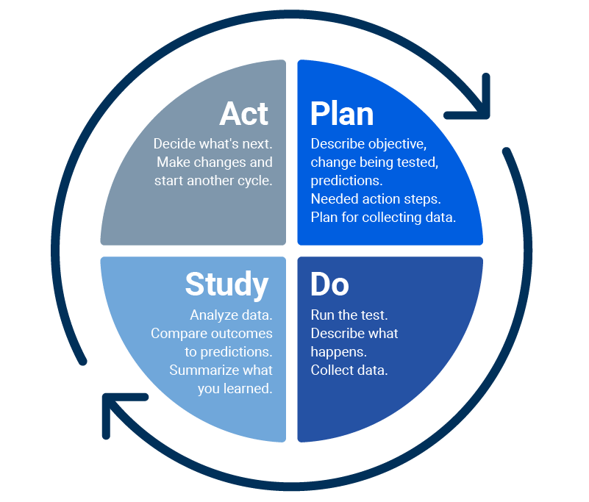
Model for Improvement Method for provider implementation of Unified QI Goals
First ask this:
Then do this:
What are we trying to accomplish?
How will we know that a change is an improvement?
What can we do that will result in improvement?
Hennepin County Ryan White Program
Subrecipient onboarding – Quality Management

Slide 23
Guiding Principles for QI Projects
QI Plan/Project(s) addresses clients and/or services for all our funding sources
QI Goal(s) is specific
QI Goal(s) is measurable
QI Goal(s) is attainable
QI Goal(s) is relevant
QI Goal(s) is time-bound
QI Goal(s) is inclusive
QI Goal(s) is equitable
QI Goal(s) is an improvement on what we accomplished year to date or last year
Staff involved in these programs have agreed to these projects and reviewed this submission
Program leadership has reviewed and agreed to this submission
QI Project/Intervention is specific, and it is clear what we are going to do to reach our goal
QI Project/Intervention is not the same project/intervention we wrote last year
Hennepin County Ryan White Program
Subrecipient onboarding – Quality Management

Slide 24
Example way of tracking QI Work
Measurable QI Goal
  QI goal/aim statement: “Improve the viral suppression rate among a cohort of clients that were unstably housed as of 12/31/23 to 75%.” (Example)
  Intervention/strategy that will help you achieve your goal:
  Staff responsible for intervention:
  How will you measure progress?
    Process measures:
    Outcome measures:
  Where will you track the data?
  How will your progress be communicated and to whom?
There should be some level of involvement, advisement, and/or feedback from: (1) Leadership, (2) Front-line staff, and (3) Clients
What resources do you need to make progress towards the goal?
How will you stay on track?
How will you adjust if things aren’t working as planned? (Quality Mgt staff is here to support you with training and/or TA if needed or desired!)
Also, keep in mind...
Hennepin County Ryan White Program
Subrecipient onboarding – Quality Management

Slide 25
Quarterly Quality Management-related Assessing and Reporting
Notes:
Aurin

Slide 26

Quarterly Reports and Calls – Quality Mgt
As part of your quarterly Qualtrics reporting, subrecipient providers report qualitative/narrative data on activities as well as trends, efforts, changes, and/or realizations at your organization related to performance measures
Providers answer a series of guided questions as well as process measures to report on the implementation at your organization of the year's chosen unified Part A QI Goals as they pertain to the organization's RW-funded work.
HC RWP Quality Management staff will present quantitative data on overall effectiveness measures as well a performance measures and QI goals as they pertain to each individual provider. This, along with previously submitted information in the Qualtrics report will form the basis for discussion in the quarterly report calls and may also be useful to share in the larger QMAC conversations.
Requests for technical assistance/training related to implementing QI are encouraged!
Trainings on QI or other topics for individual providers as well as in larger, more comprehensive settings will be developed and conducted.
Hennepin County Ryan White Program
Subrecipient onboarding – Quality Management

Slide 27

Aggregate, TGA-level Quarterly Assessments in the QMAC
HC RWP staff will present aggregated, TGA-level quantitative data related to performance measures and the unified RW Part A QI goals to the QMAC for discussion and to determine possible future QI needs.
Highlights from discussions with individual providers during the quarterly report calls may be useful to contribute for sharing and learning.
HC RWP staff will also present relevant epi data and may break down the performance measure information demographically or by other means for further assessment and analysis by the QMAC and to determine possible future QI needs.
Hennepin County Ryan White Program
Subrecipient onboarding – Quality Management

Slide 28
Quality Assurance: Annual Site Visits
HC RWHAP staff meets with all Part A funded providers every spring to assess performance and ensure programmatic compliance with universal standards, service standards, and eligibility requirements.
HC RHWAP Grants Management, HIV Services Planning, and Quality Management staff will review client charts.
Contract Managers will meet with key staff to review finance, staffing, contract compliance, and program updates.
Any findings that do not meet standards are discussed during the site visit – providers may have a deadline to provide documentation that was not available during the site visit.
Some findings may require the submission of a Corrective Action Plan within 60 days. The purpose is not to be punitive but to ensure that clients receive a comparably high level of service at any provider in the Ryan White system of care.
Hennepin County Ryan White Program
Subrecipient onboarding – Quality Management

Slide 29
Quality Learning Community
Notes:
Aurin

Slide 30
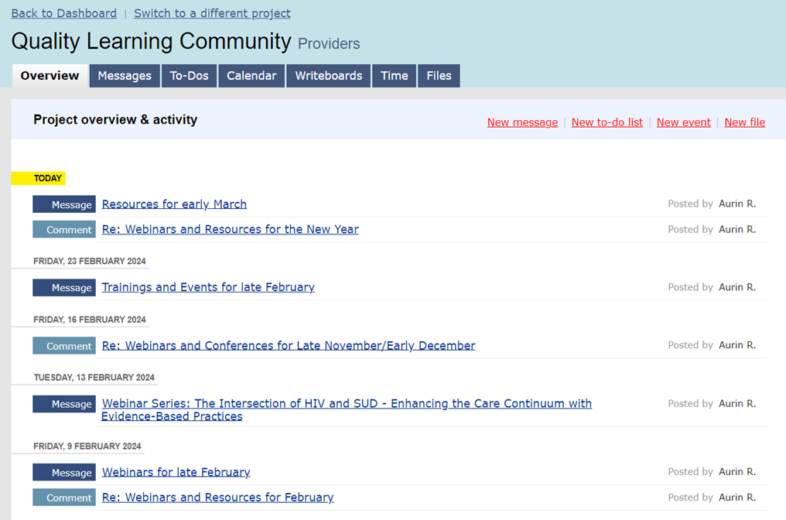
Quality Learning Community (QLC)
Each month, information about relevant webinars, trainings, local events, and links to information that can help inform and supplement your work and quality efforts will be posted on the interactive Basecamp web page.
Providers, community members, and consumers are all welcome to join. Send an email to Scott.Bilodeau@hennepin.us to be included in email notifications.
Hennepin County Ryan White Program
Subrecipient onboarding – Quality Management

Slide 31
Early Identification of Individuals with HIV/AIDS (EIIHA)
Notes:
Aurin

Slide 32
EIIHA Overview
Early Intervention of Individuals with HIV/AIDS (EIIHA) is the identifying, counseling, testing, informing, and referring of undiagnosed and diagnosed individuals to appropriate services, as well as linking newly diagnosed HIV positive individuals to medical care.
The goals are to increase:
  the number of individuals aware of their status (testing);
  the number of HIV positive individuals who are in medical care (linkage); and
  the number of HIV negative individuals referred to services that contribute to keeping them HIV negative (referrals) – sometimes referred to as a Status Neutral Approach.
Hennepin County Ryan White Program
Subrecipient onboarding – Quality Management

Slide 33
EIIHA Background
3-Year EIIHA Cycle
Per the 2009 Ryan White Act reauthorization, Planning Council is required to assess needs of those unaware of their status.
EIIHA plans and efforts impact Part A Supplemental funding.
The Council and grant recipients and subrecipients work towards reducing the proportion of PWH who are unaware of their status.
HRSA requires Parts A and B recipient funders to have EIIHA plans in their grant applications – this accounts for 33% of Part A’s application score.
“Diagnose” is the first pillar of Minnesota’s and the Part A 13-county grant area’s Integrated HIV Prevention and Care Plan
Year 2: Assess & Report on Plan Progress (2025)
Year 3: Assess & Report on Plan Progress (2026)
Year 1: Develop Plan and Goals (2024)
Hennepin County Ryan White Program
Subrecipient onboarding – Quality Management

Slide 34
Minnesota EIIHA Workgroup
Consists largely of providers (Ryan White and MDH-funded) involved with EIS-related outreach testing and care linkage services.
Reviews epidemiological data and makes recommendations to recipients and to the Council.
Meets annually.
Creates, monitors, and evaluates progress towards EIIHA goals over three year cycles.
Meetings announced at QMAC, Basecamp, and through other community distribution lists. Contact HC RW Program Quality Management staff if interested.
Hennepin County Ryan White Program
Subrecipient onboarding – Quality Management

Slide 35

EIIHA Related Services (Ryan White and RW-adjacent services)
Early Intervention Services
Counseling and HIV Testing
Syringe Services
HIV Education & Outreach
Status Neutral / Whole Person Prevention and Care
Partner Services
PrEP
Hennepin County Ryan White Program
Subrecipient onboarding – Quality Management

Slide 36

So... Quality Management in a "nutshell"...
The goal of quality management is to ensure services meet intended standards of care, to be compliant, and to improve services, client health outcomes, and/or client satisfaction
To do so, we establish and assess performance measures quarterly for services with 15+% service utilization, which, in addition to looking at the demographic breakdown of the data, general epi trends, and past performance, allow us to unearth needs such as addressing demonstrated disparities (for example). This may form the basis for a good goal for the quality improvement plan!!
QI is a fun and oftentimes interesting opportunity to experiment and try out some new approaches together in a measured way to improve services and client health outcomes and satisfaction – all while learning together in the process!
HC RWP Quality Management staff are here to clear any confusion you may have and to support you in reaching QI Goals!
Hennepin County Ryan White Program
Subrecipient onboarding – Quality Management

Slide 37

Please contact me at any time with questions or to provide additional feedback or input
Ask me a question
Run a QI scenario or some other thing by me
Share a success or challenge that might be brought up in QMAC or on Basecamp for others to consider
Find out who to contact or where to go for information
Request to be added to Basecamp
Request TA or trainings
Scott Bilodeau
Quality Management Coordinator
Scott.Bilodeau@Hennepin.us

