Slide 1
Public Health

Slide 2

Ryan White Systems Overview

Slide 3

Purpose
To highlight the various webpages and apps the Ryan White Program uses to collect and share data and information with providers and stakeholders.

Slide 4
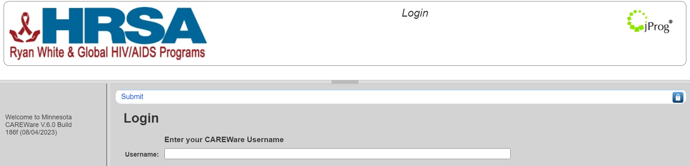
CAREWare 6
https://mncw.dhs.state.mn.us/careware/rs/index.htm
HRSA-supported, web-based software used to manage HIV client-level service data
Login required
Service data is entered by providers each month
Tools and resources at https://mn365.sharepoint.com/sites/MDH/careware/SitePages/Home.aspx
Minnesota CAREWare Help Desk health.cwpems@state.mn.us

Slide 5
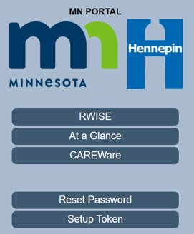
At a Glance screen
Access at: https://mnce.dhs.state.mn.us/MNCEPortal
Login required
Providers use to verify a client's eligibility for Ryan White services
DHS online enrollment documents: https://edocs.mn.gov/forms/DHS-3539-ENG
Reach out to DHS HIV Services team for questions about eligibility data shown on the At A Glance screen.

Slide 6
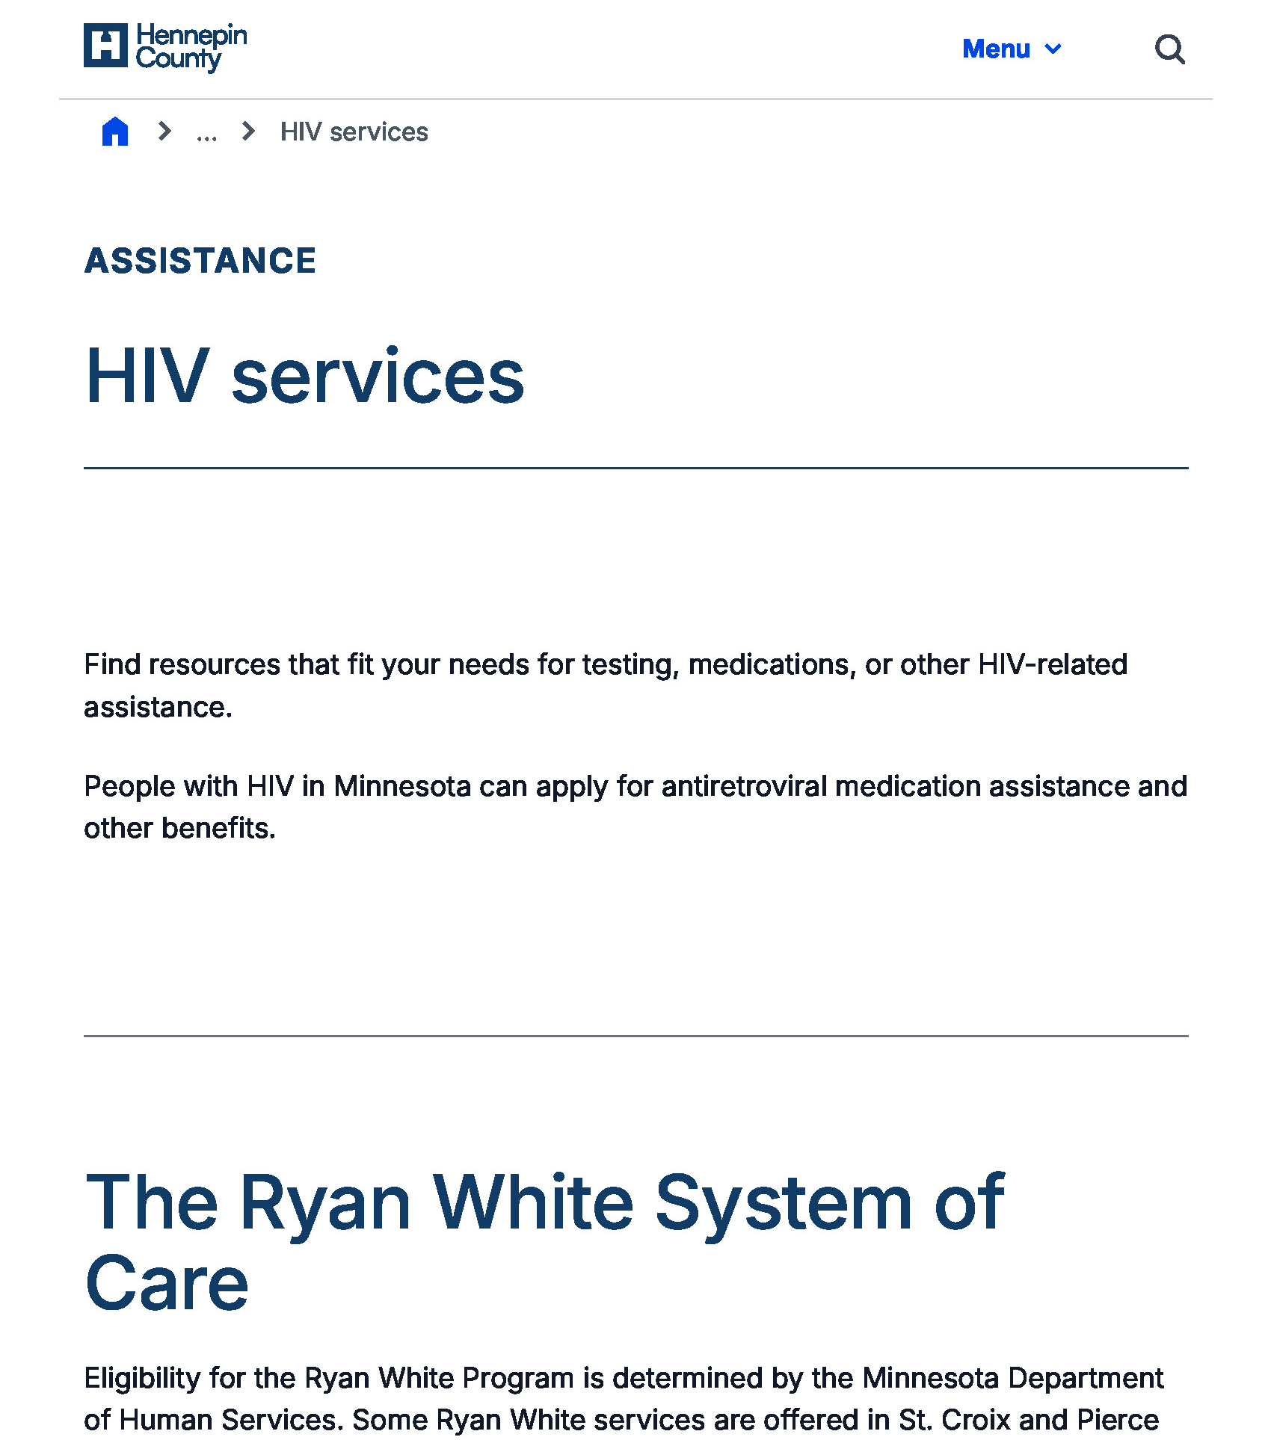
HIV Services Webpage
https://www.hennepincounty.gov/ryan-white
A resource for people with HIV looking for testing, medications, or other HIV-related assistance, including Ryan White services and MCHACP

Slide 7
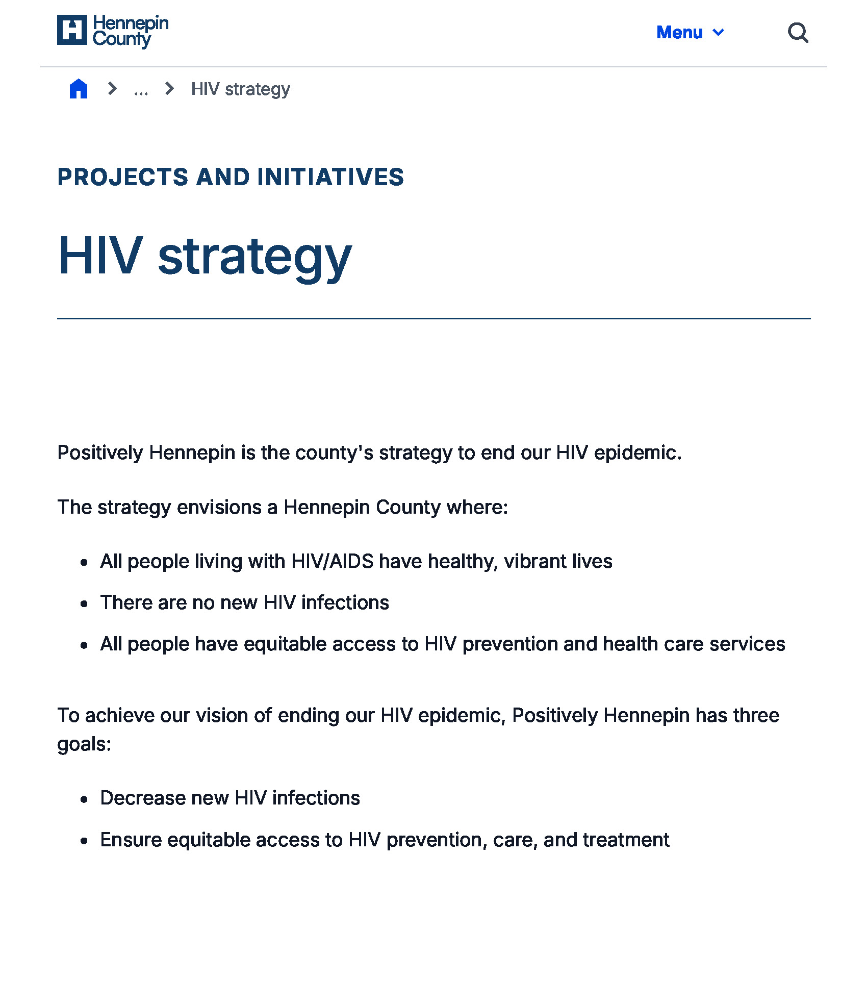
HIV Strategy Webpage
https://www.hennepincounty.gov/government/projects-initiatives/health/hiv-strategy
An overview of Positively Hennepin, the county’s strategy to ending our HIV epidemic

Slide 8
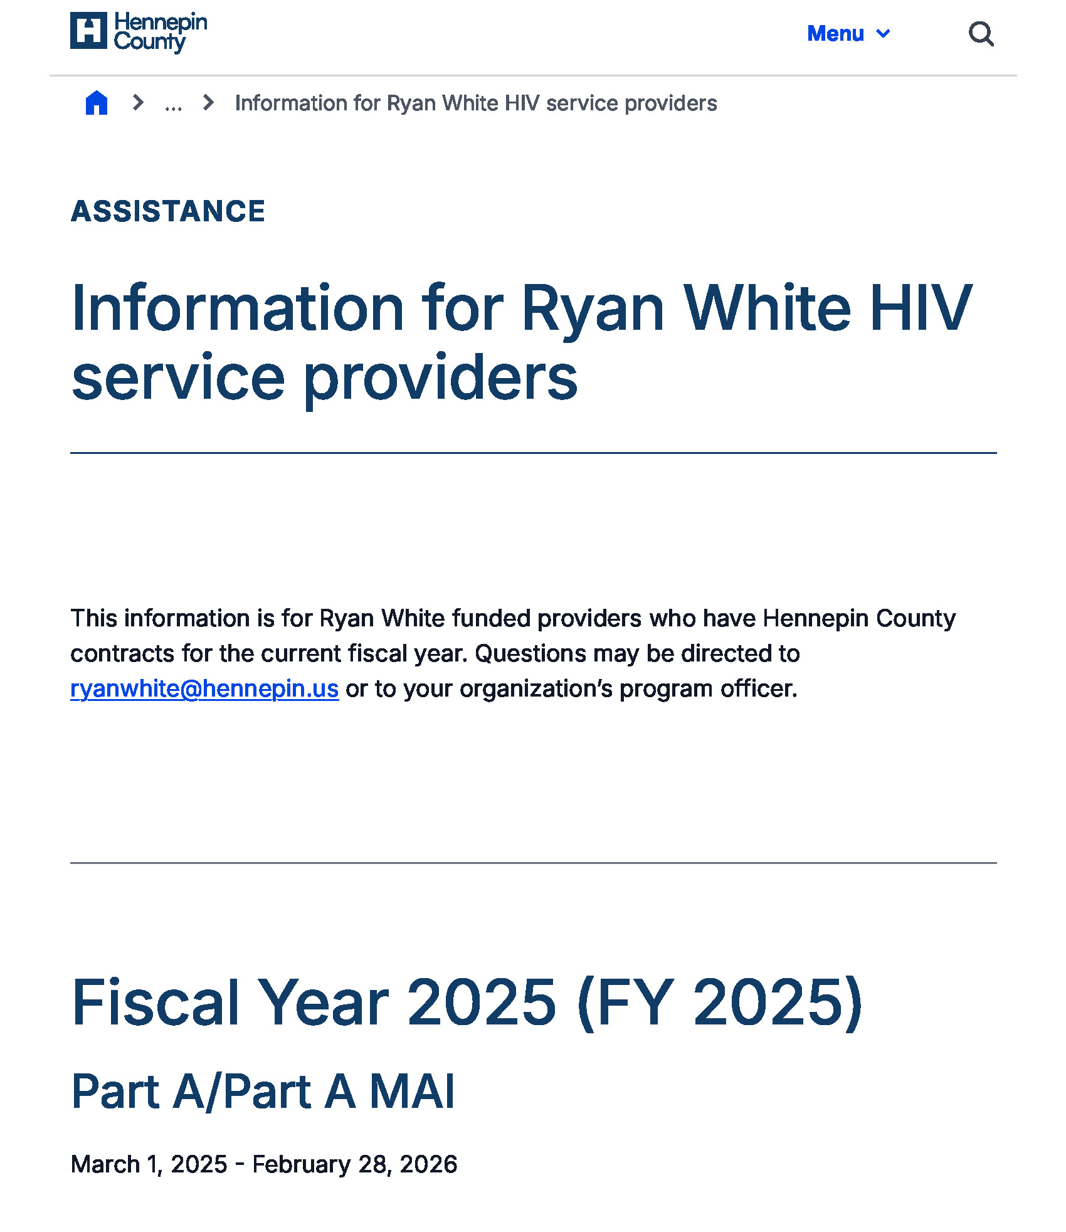
Information for Ryan White HIV Service Providers Webpage
https://www.hennepincounty.gov/services/assistance/health-care/information-for-ryan-white-hiv-service-providers
Information for Ryan White funded service providers with Hennepin County Part A or Part B/Rebate contracts, includes contract and invoice guidance/information, quality management requirements and reports, Rapid StART standards and resources, provider onboarding resources, service standards, and other relevant resources

Slide 9
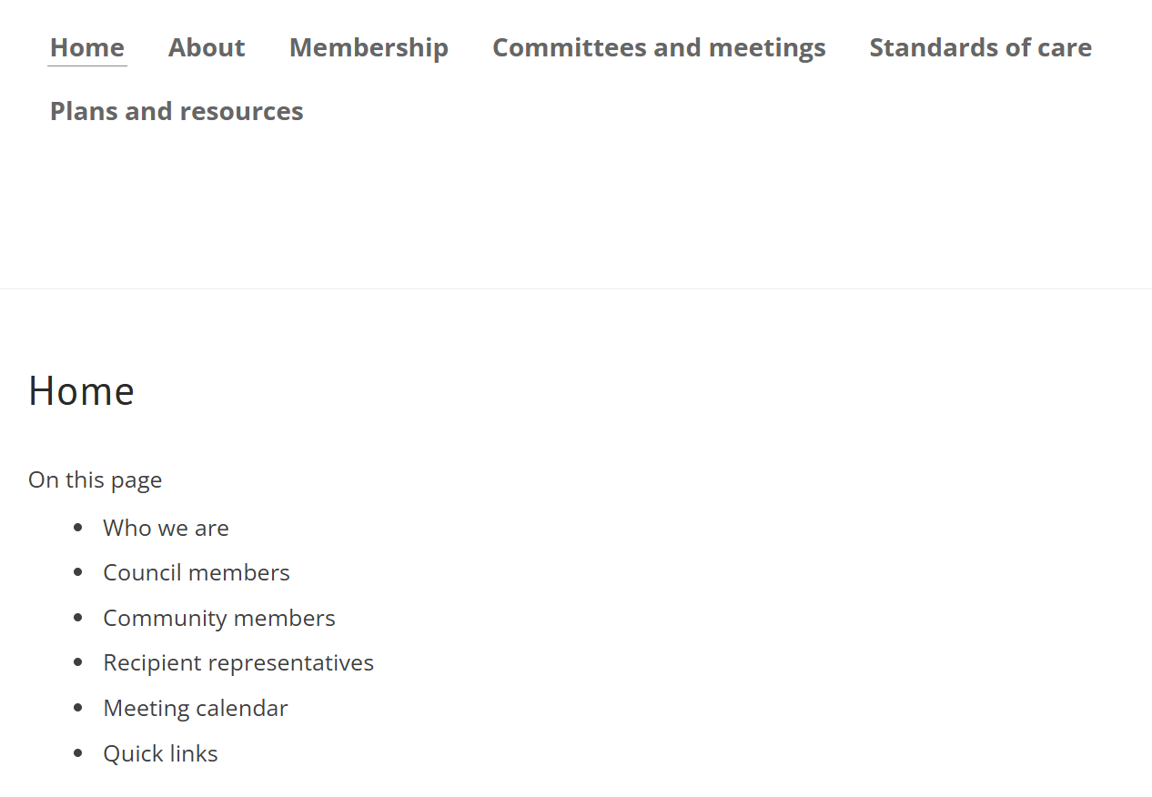
HIV Council Website
https://www.mnhivcouncil.org
Audience is:
  Current and prospective members of the MN Council for HIV/AIDS Care and Prevention
  Providers and consumers looking for Minnesota Ryan White Program service standards
  People looking for more information on the Ryan White system of care

Slide 10
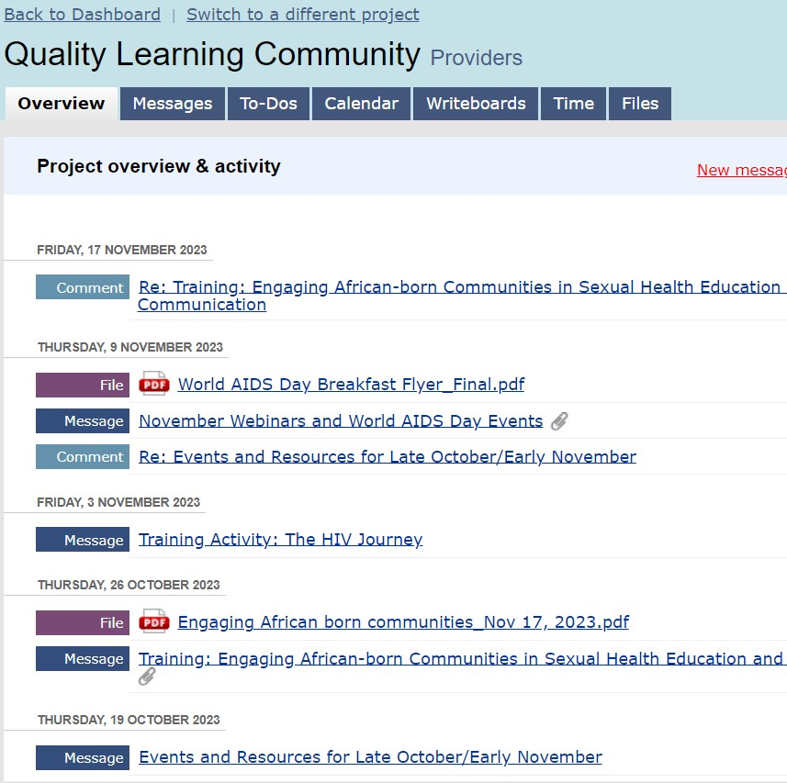
Basecamp
https://launchpad.37signals.com/basecamp/1096789/signin
Online collaboration app
Organized by project
  Quality Learning Community
  Centralized Eligibility Communications
  Specific projects
Send messages, view, and share documents
Request access or password reset to RyanWhite@hennepin.us

Slide 11
Qualtrics Online Surveys
Hennepin County uses this web-based survey platform to collect reports and information from subrecipients
  Quarterly reports
  Exhibit A for interpretation services
Anytime a report/survey is due in Qualtrics, a member of the Hennepin County Ryan White Program team will send out an email with guidance and the link

Slide 12
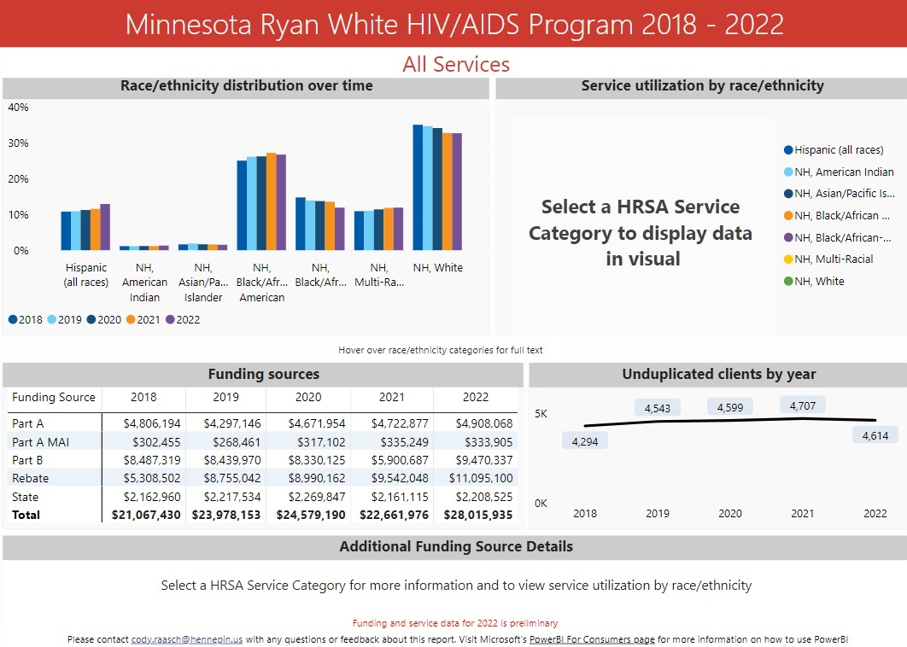
Data Dashboard
  https://bit.ly/3uT8FMI
  Public
  Quantitative data on service and expenditure data
  Audience is HIV council members to make prioritization and allocation decisions
  Updated annually
  Accessed from HIV Council website and Ryan White webpage

