Slide 2

Ryan White Subrecipient Monitoring

Slide 3
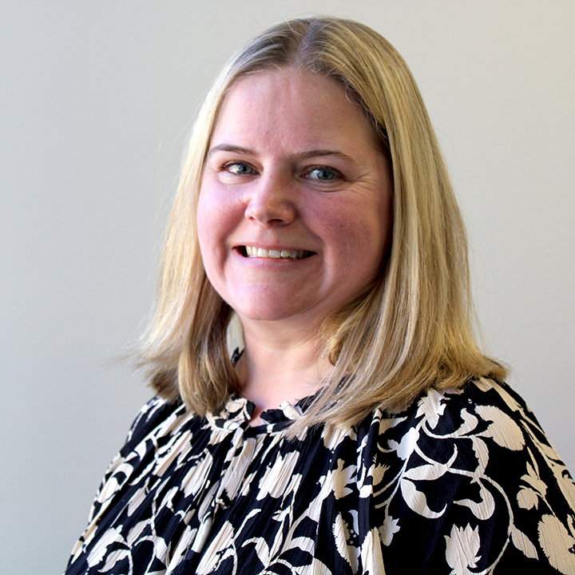




Hennepin County Ryan White
Subrecipient Monitoring Team
Carissa Weisdorf
Lead HIV Services Planner
Carissa.Weisdorf@Hennepin.us
Scott Bilodeau
Quality Management Coordinator
Scott.Bilodeau@Hennepin.us
Eriika Etshokin
Ryan White Grants Supervisor
Eriika.Etshokin@Hennepin.us
Jeremy Stadelman
Ryan White Program Officer
Jeremy.Stadelman@Hennepin.us
Cody Raasch
Ryan White Data Analyst
Cody.Raasch@Hennepin.us

Slide 4
Subrecipient Monitoring
Monitoring is a critical aspect of the implementation of the Ryan White HIV/AIDS Program (RWHAP).
Like all RWHAP funding recipients, Hennepin County is responsible for adequate oversight and monitoring of all activities supported by the federal award, including subawards and contracts.
Hennepin County monitors subrecipient conduct through annual site visits, quarterly reporting, invoice/expenditure and client-level data (CAREWare) reviews.
Subrecipient Monitoring is an opportunity to learn together, share best practices, troubleshoot new strategies, and identify opportunities for collaboration, training, and technical assistance as needed.
Hennepin County Ryan White Program
Subrecipient onboarding – Subrecipient Monitoring

Slide 5
Site Visits
Site visits are done annually and include fiscal/programmatic interviews with site staff, and chart reviews to ensure adherence to service standards, universal standards, and program eligibility requirements.
In early Spring, all providers will receive communication from Hennepin County staff with guidance and scheduling to set up the site visit. Each site visit will include a review of client charts from the previous year.
The number of clients to be reviewed at each site is determined based upon the number of Ryan White clients served at that site:
1-50 Clients: 100% of charts reviewed | 501 – 1000 Clients: 10% of charts reviewed (maximum of 75)
51-100 Clients: 50% of charts reviewed | 1000+ Clients: 5% of charts reviewed (maximum of 75)
101 – 500 Clients: 20% of charts reviewed (maximum of 75) | 25% of charts pulled are reviewed for compliance with Universal Standards
Hennepin County Ryan White Program
Subrecipient onboarding – Subrecipient Monitoring

Slide 6
Quarterly Reports
Overview
Due Dates
Quarterly Reports are required from each provider for each Hennepin County managed Ryan White contract. The report is meant to provide a progress update on service performance, QI goals, provide updates on any programmatic changes, and identify technical assistance needs
A week before they are due, all providers will receive an email reminder with a link to the Qualtrics report.
Only one person from each organization is to submit the report – it must be completed and submitted on the same computer.
Resources for submission are available on the Ryan White HIV Services- Hennepin County webpage.
The quarterly reports will include a prompt for providers to select a time for a follow-up quarterly meeting.
Quarter 1 – due July 20th
  Part A/MAI activities March 1, 2025 – May 31, 2025
  Part B/Rebate activities April 1, 2025 – June 30, 2025
Quarter 2 – due October 20th
  Part A/MAI activities June 1, 2025 – August 31, 2025
  Part B/Rebate activities July 1, 2025 – September 31, 2025
Quarter 3 – due January 20th
  Part A/MAI activities September 1, 2025 – November 30, 2025
  Part B/Rebate activities October 1, 2025 – December 31, 2025
Quarter 4 – due April 20th
  Part A/MAI activities December 1, 2025 – February 28, 2026
  Part B/Rebate activities January 1, 2026 – March 31, 2026

Slide 7

Quarterly Calls
Quarterly Calls are an opportunity for Hennepin County staff to learn more about "on the ground" service provision and offers providers a recurring check-in point to ask questions, give feedback, and report program changes.
When completing the Quarterly Report in Qualtrics, providers will be prompted to select a time in the next two weeks to conduct a Quarterly Call with Hennepin County's Ryan White staff.
Provider staff is responsible to ensure appropriate staff who can speak to the agenda items listed below participate in these calls.
Agenda items will include the following:
Review of CAREWare data | Staffing Changes
Review of spending to date | Grievances/Wait List
CQM/QI Plan Progress | Technical Assistance (TA) and Training Needs
Site Visit Findings Discussion

Slide 8
Performance Measures
Your contract defines your performance goals in Section 2, Performance Measures.
Progress towards reaching these Performance Measures is measured and discussed during quarterly calls based on subrecipient data in CAREWare.
Any time the budget amount of a contract is adjusted, the Performance Measures will be adjusted accordingly.
Goals include effectiveness measures and efficiency measures as outlined below:
Efficiency measures
  Number of clients served
  Number of HIV tests
Effectiveness measures
  Viral suppression rates
  Retention in care rates
  Percent of priority population reached

